Slide 1
HTML Forms with ASP.NET

Slide 2
Mr. M.R. Solanki
Sr. Lecturer, Information Technology,
manish_ratilal2002@yahoo.com
SBMP

Slide 3
Learning Outcomes
Students will be able to:
Create ASP.NET project and test the working of default (index) page on browser using IIS

Slide 4
Web Forms with ASP.NET

Slide 5
ASP.NET
ASP.NET is a web development platform, which provides a programming model, a comprehensive software infrastructure and various services required to build up robust web applications for PC, as well as mobile devices.
ASP.NET works on top of the HTTP protocol, and uses the HTTP commands and policies to set a browser-to-server bilateral communication and cooperation.
ASP.NET is a part of Microsoft .Net platform. ASP.NET applications are compiled codes, written using the extensible and reusable components or objects present in .Net framework.
The ASP.NET application codes can be written in any of the following languages:
C#
Visual Basic.Net
Jscript
J#

Slide 6
ASP.NET Web Forms Model
HTTP is a stateless protocol.
ASP.NET framework helps in storing the information regarding the state of the application, which consists of:
Page state
Session state
The page state is the state of the client, i.e., the content of various input fields in the web form.
The session state is the collective information obtained from various pages the user visited and worked with, i.e., the overall session state. Example: shopping cart.
User adds items to a shopping cart. Items are selected from a page, say the items page, and the total collected items and price are shown on a different page, say the cart page.
ASP.NET session state and server side infrastructure keeps track of the information collected globally over a session.

Slide 7
The ASP.NET Component Model
The ASP.NET component model provides various building blocks of ASP.NET pages. Basically it is an object model, which describes:
Server side counterparts of almost all HTML elements or tags, such as <form> and <input>.
Server controls, which help in developing complex user-interface. For example, the Calendar control or the Gridview control.
When a user requests an ASP.NET page, the IIS delegates the processing of the page to the ASP.NET runtime system.
The ASP.NET runtime transforms the .aspx page into an instance of a class, which inherits from the base class page of the .Net framework. Therefore, each ASP.NET page is an object and all its components i.e., the server-side controls are also objects.

Slide 8
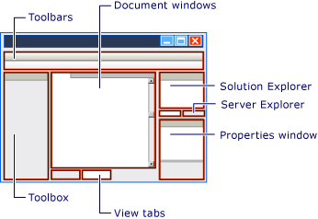

Slide 9
If we don’t get the project type as “ASP.NET Web Application” then follow the steps mentioned in upcoming slides

Slide 10
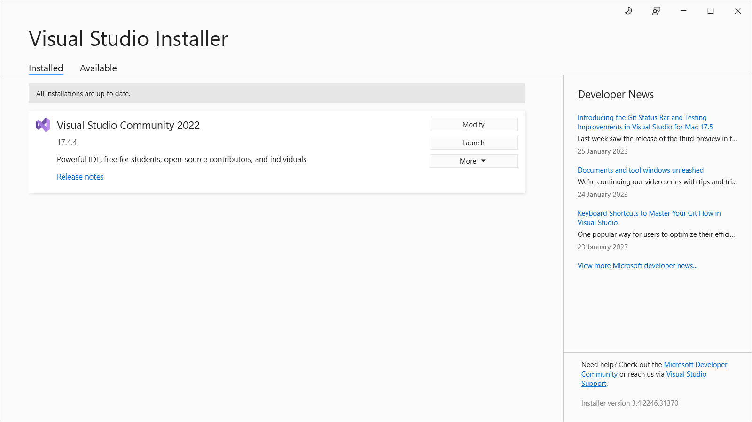
Web Form option is not visible
Click on Modify button

Slide 11
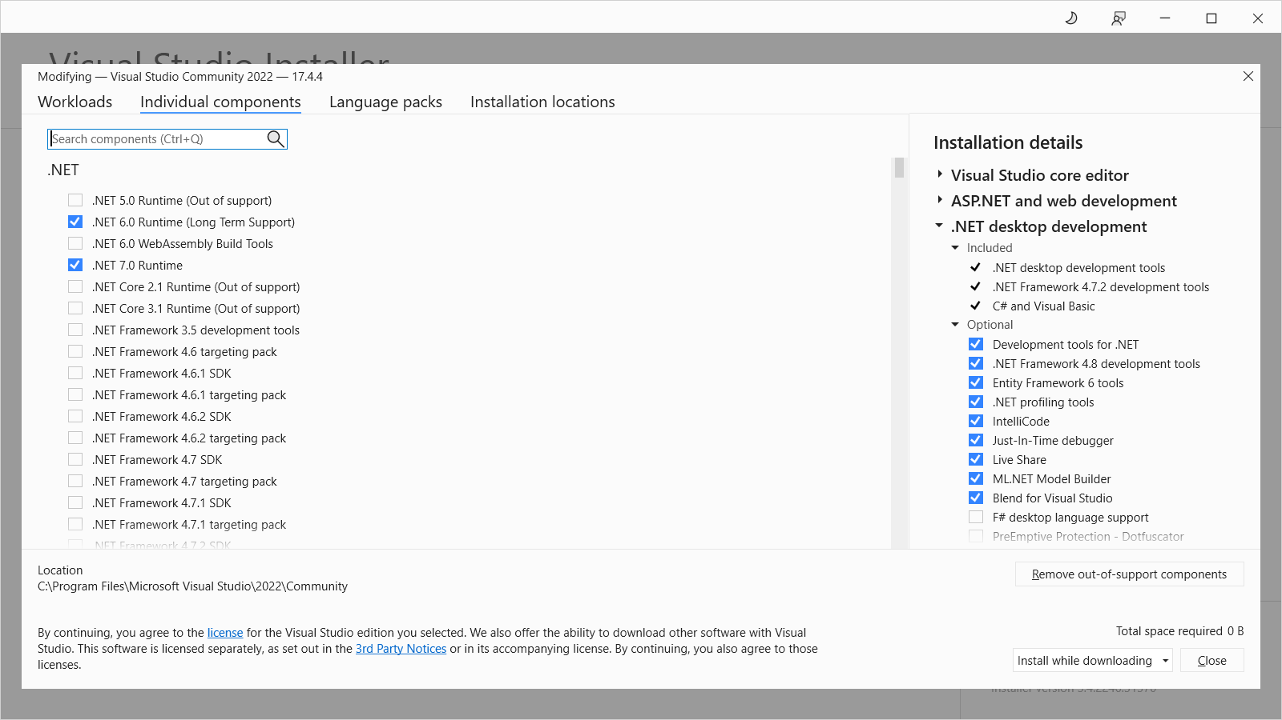
Click on “Individual components” tab Select “.NET framework 4.8.1 targeting pack” and “.NET Framework project & item templates”

Slide 12
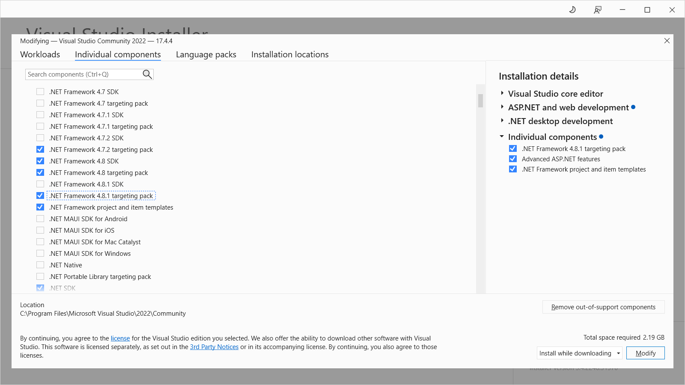

Slide 13
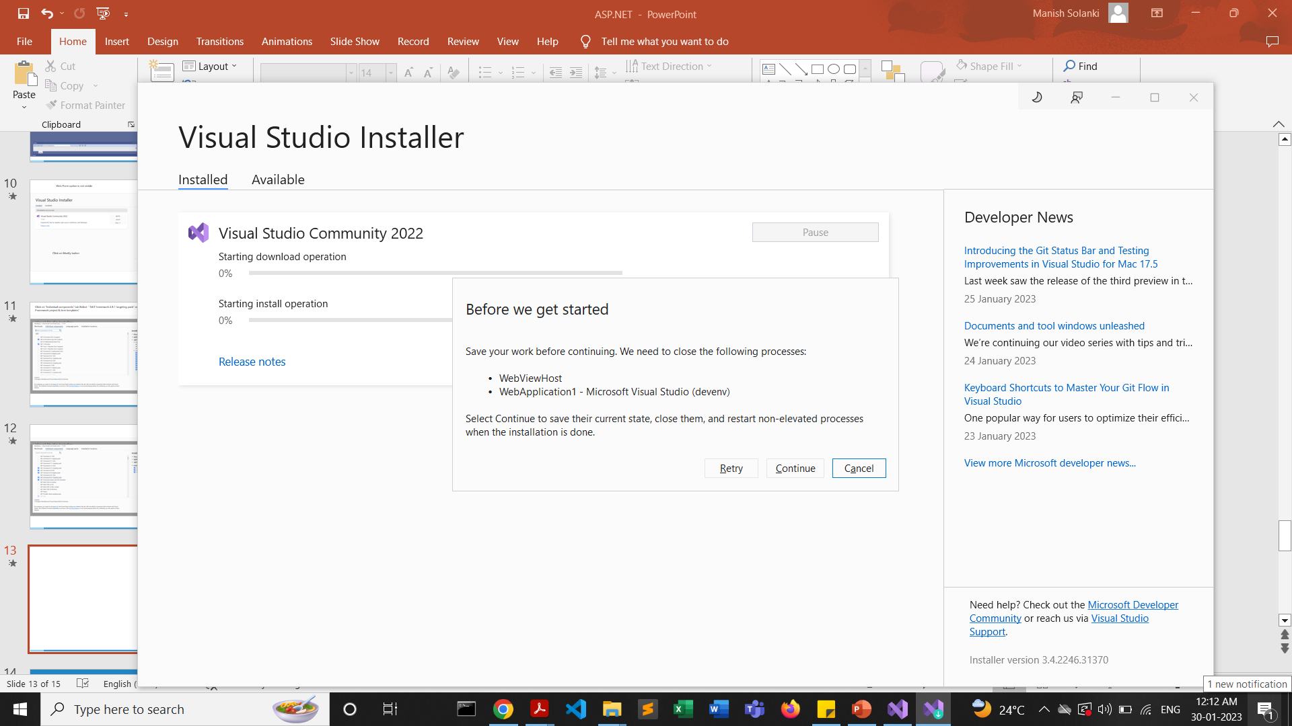

Slide 14
Now, Create a new ASP.NET Web Application

Slide 15
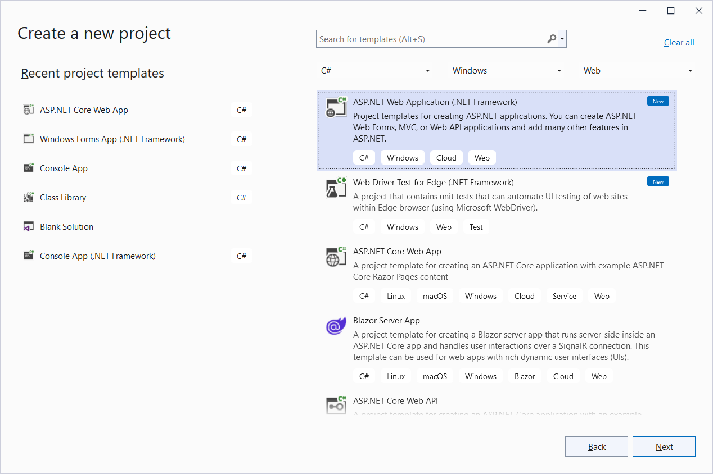

Slide 16
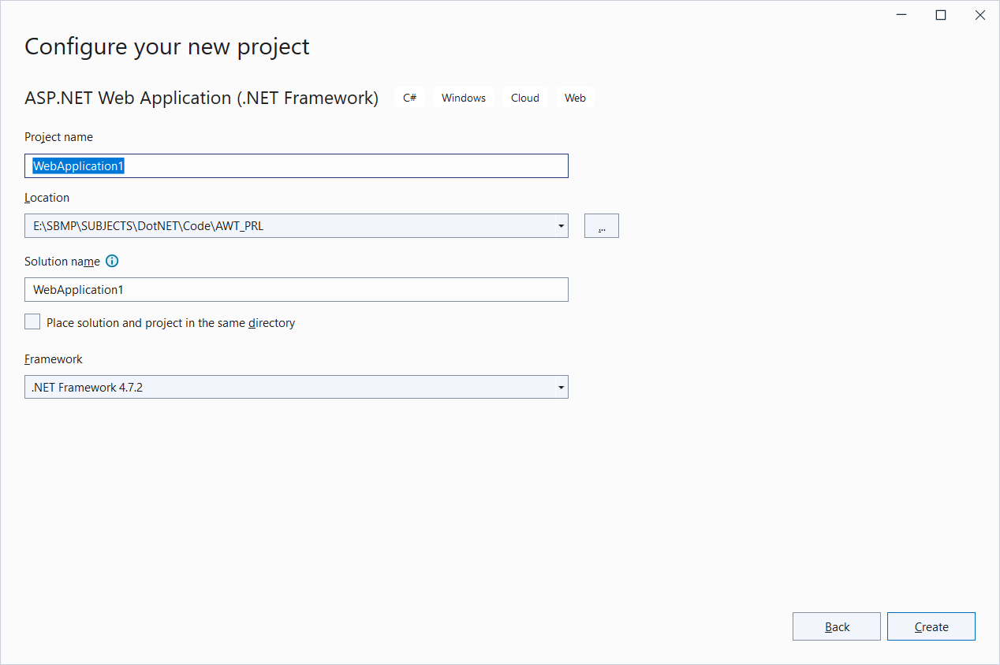

Slide 17
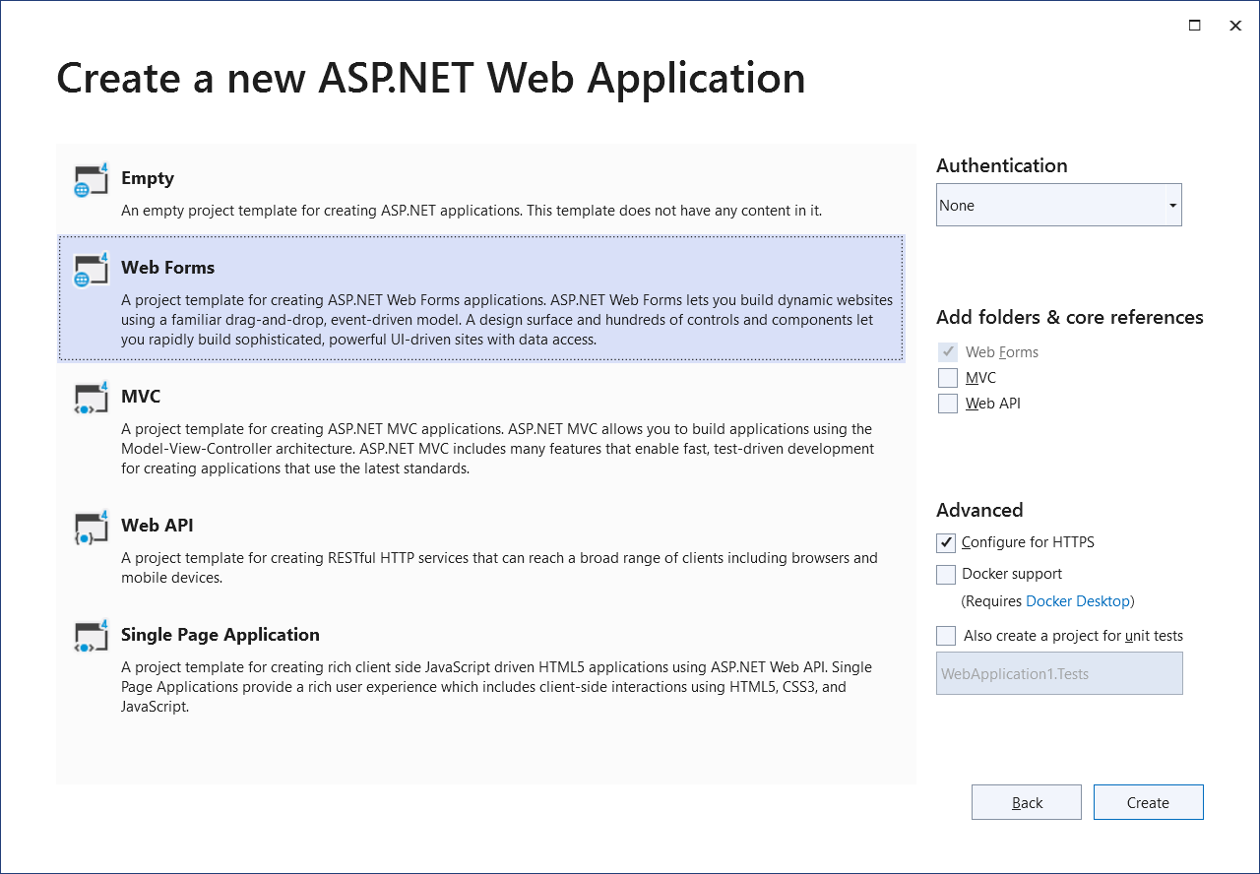

Slide 18
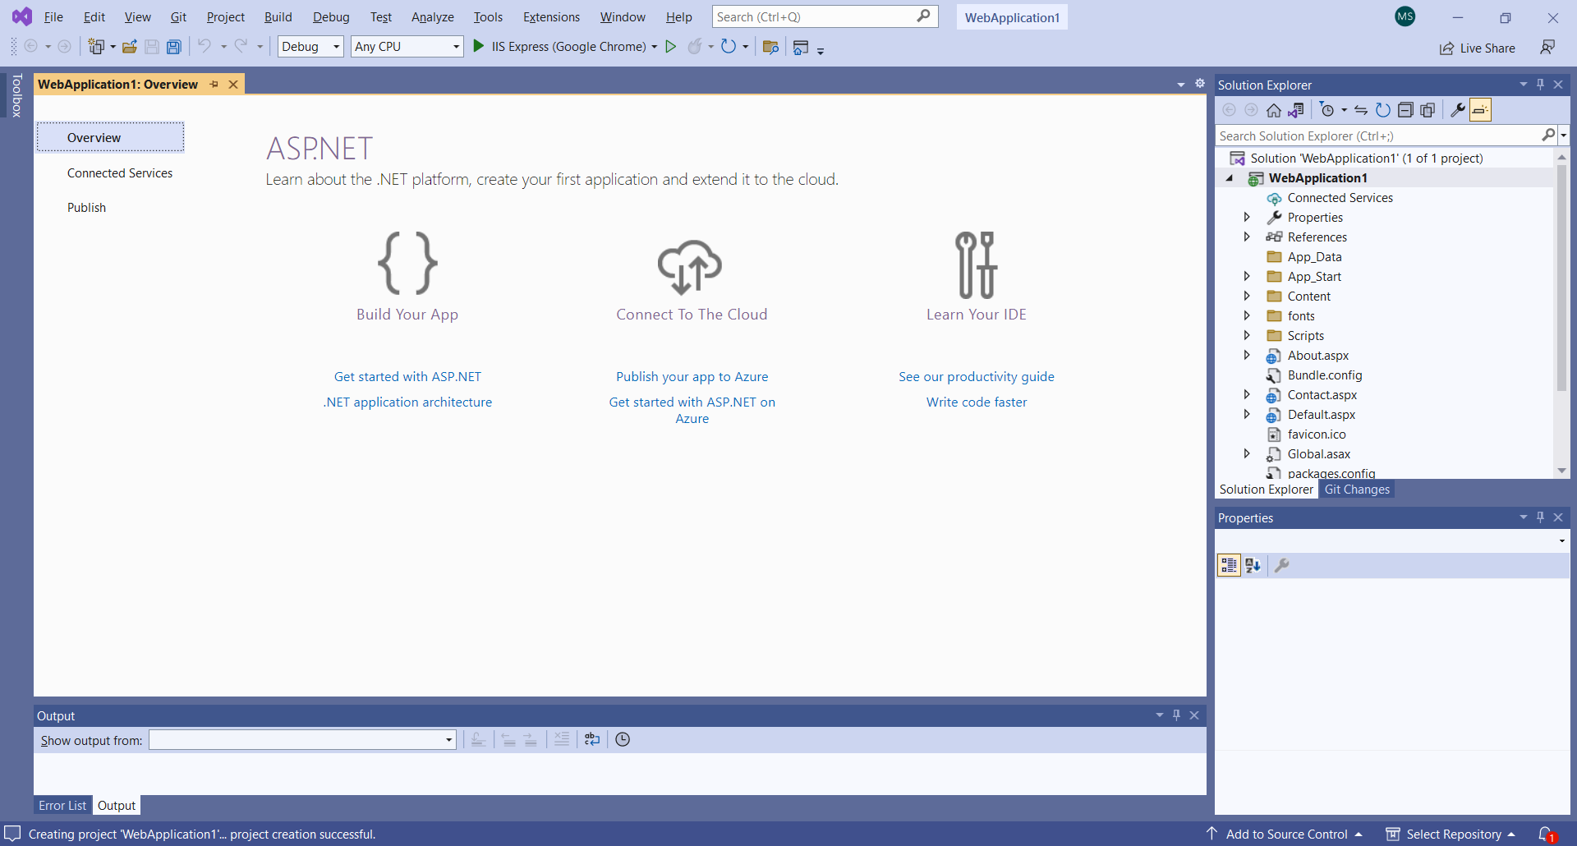

Slide 19
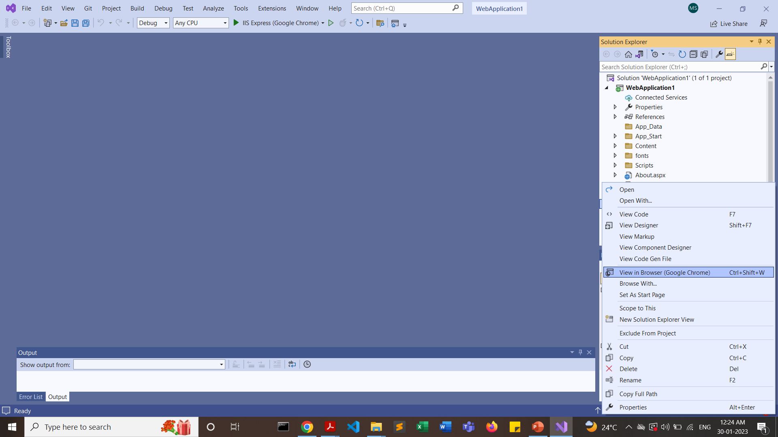
Right Click on “Default.aspx” file and view it in browser

Slide 20
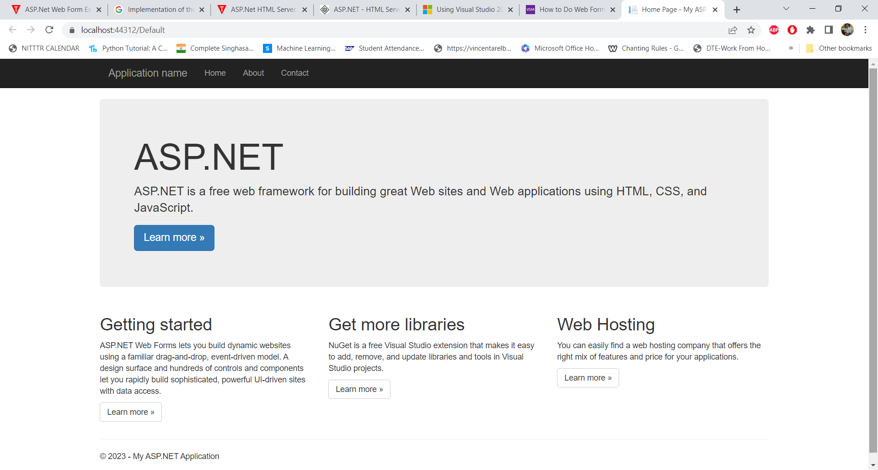
A default.aspx file is a startup file. When we run the project this file executes first and display a home page of the site.

Slide 21
Default.aspx contains the HTML and asp code that defines the form, Default.aspx.cs (for C# coding)
Default.aspx.vb (for VB coding)
contains the code in the language you have chosen and this code is responsible for the actions performed on a form.
Solutions may contain one or more projects.
A project contains content files, source files, and other files like data sources and image files. Generally, the contents of a project are compiled into an assembly as an executable file (.exe) or a dynamic link library (.dll) file.
Typically a project contains the following content files:
Page file (.aspx)
User control (.ascx)
Web service (.asmx)
Master page (.master)
Site map (.sitemap)
Website configuration file (.config)

Slide 22
Creating a Web Form

Slide 23
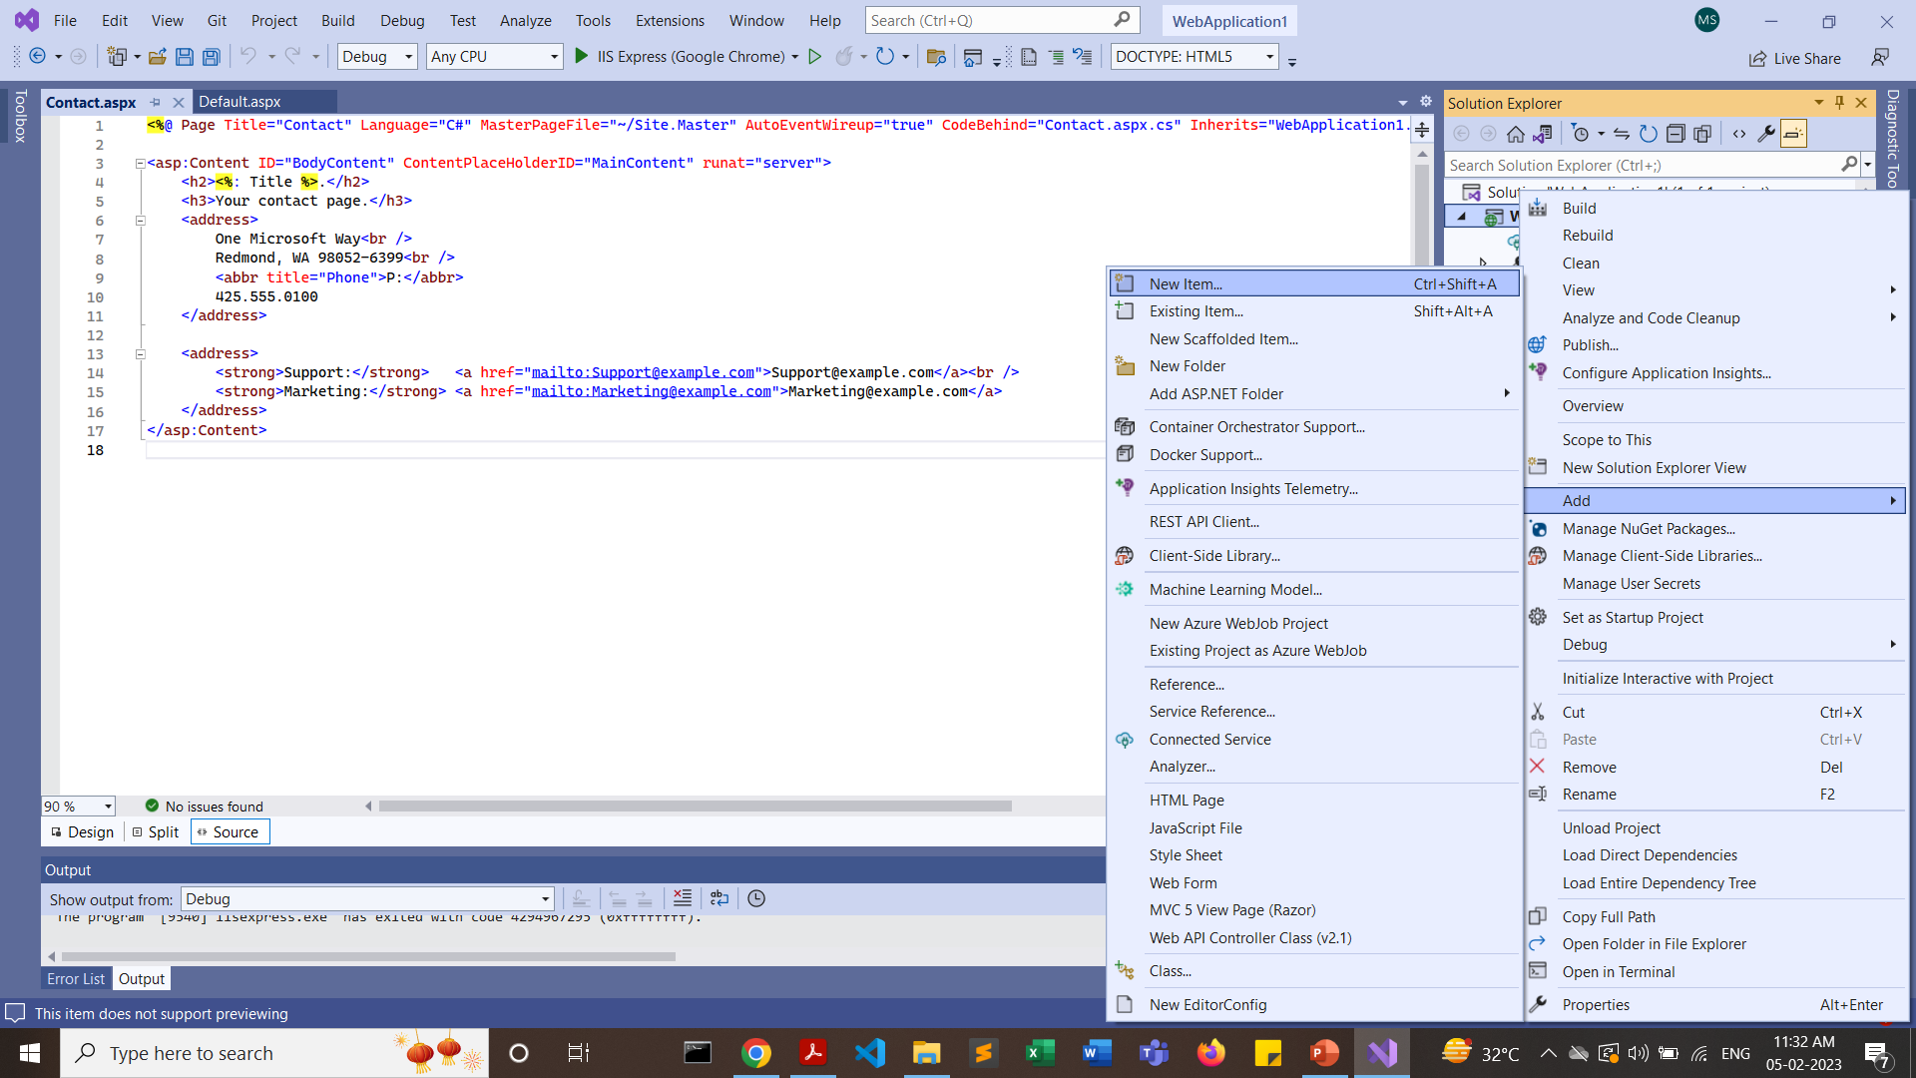
Create a solution and Right click on the project folder -> add item-> web form

Slide 24
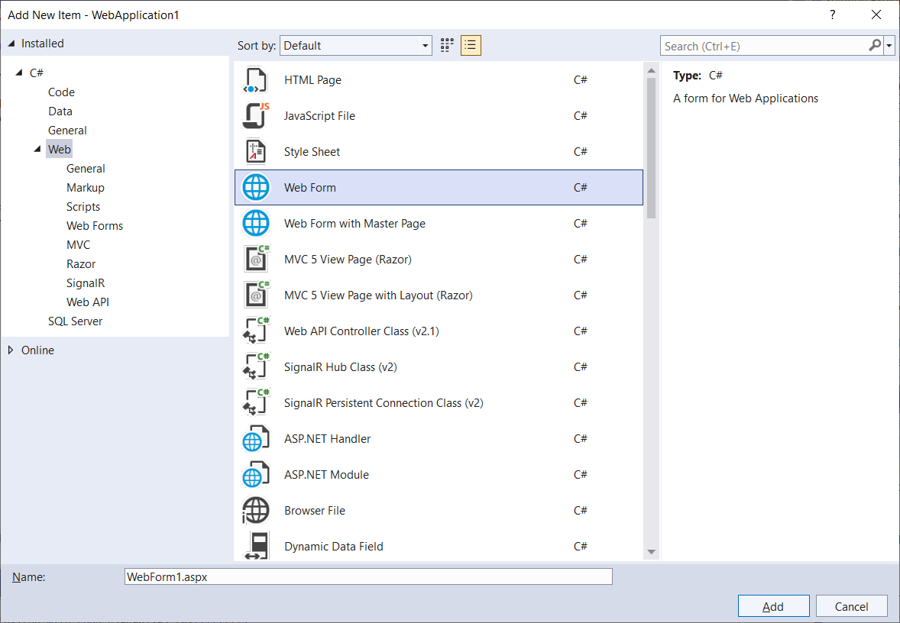
Select “Web Form” and press on “Add”

Slide 25
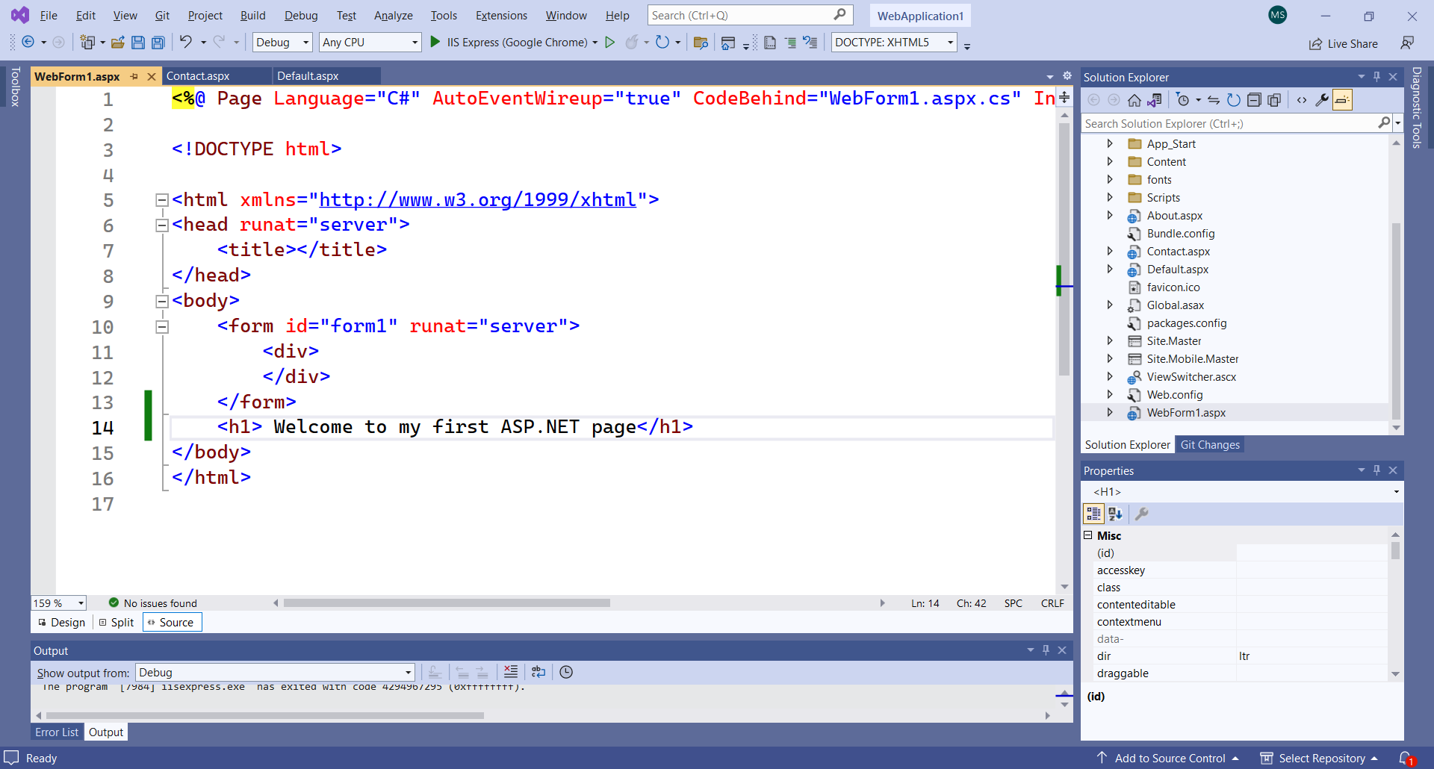
Write HelloWorld text & Run the page

Slide 26
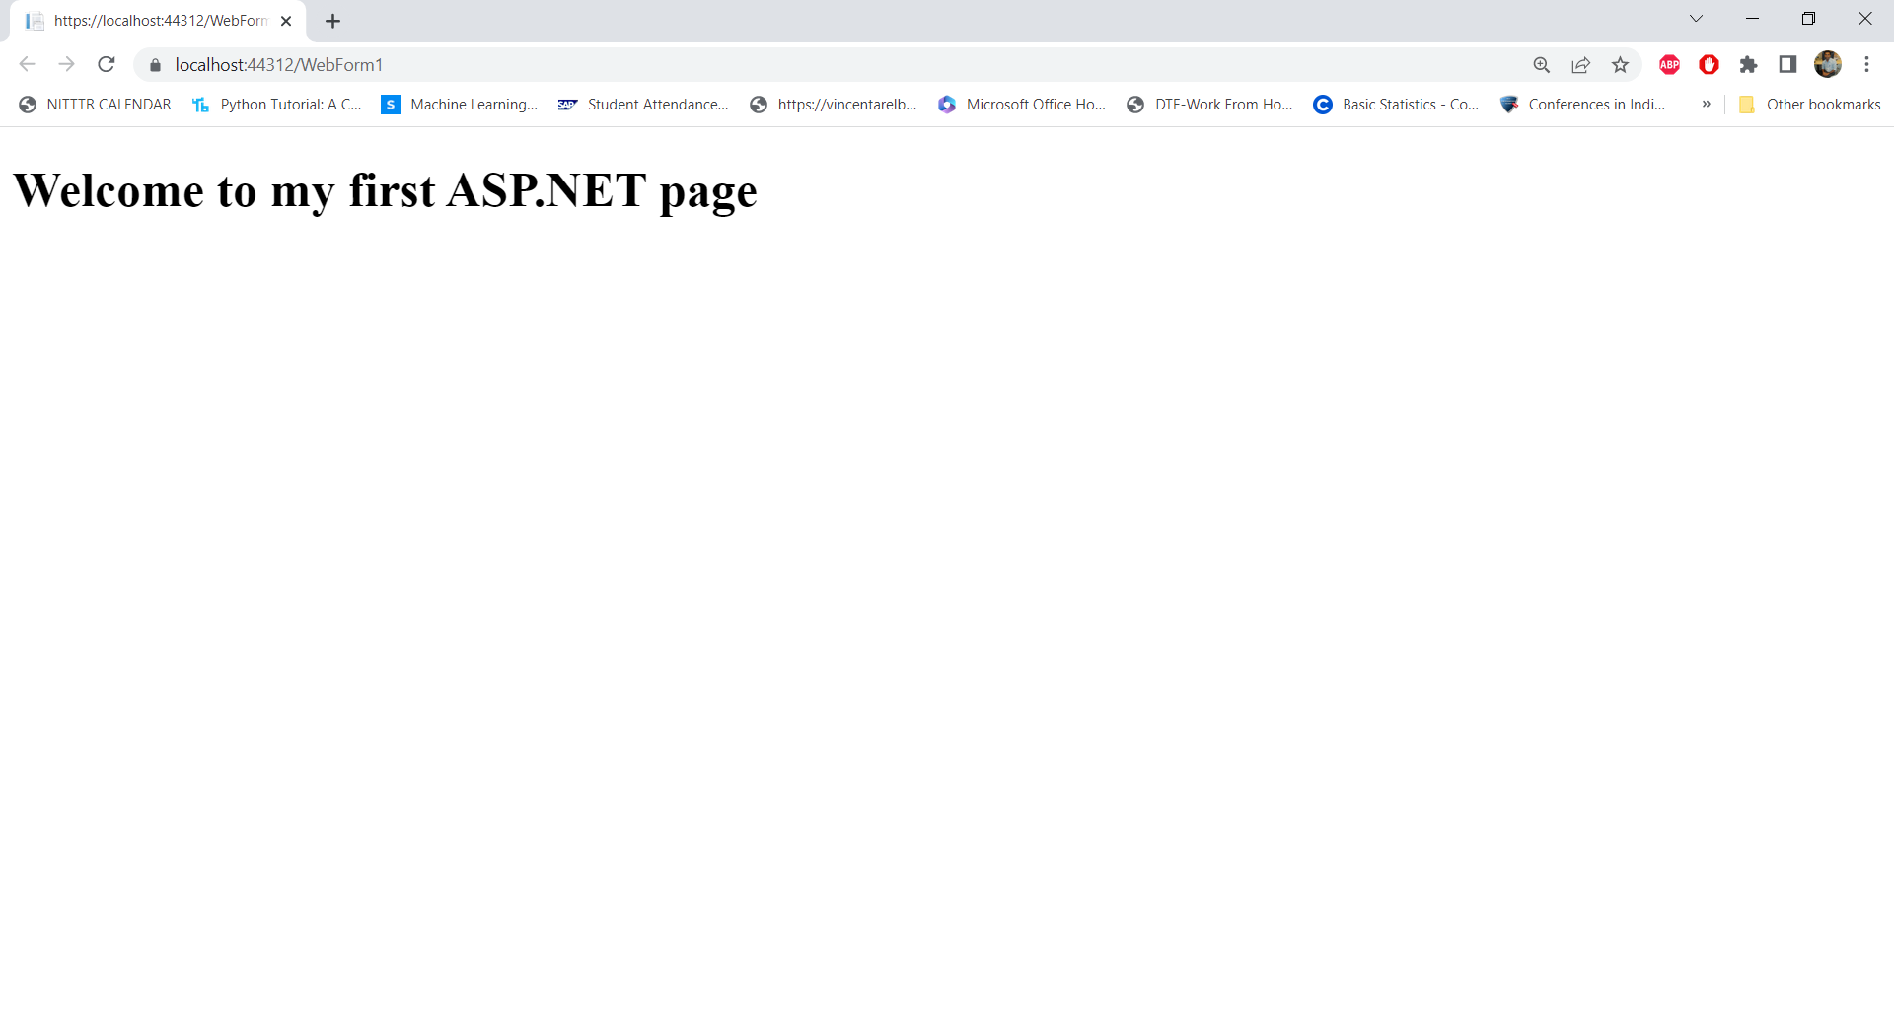

Slide 27
HTML Server Controls Vs Web Controls

Slide 28
HTML server controls
The HTML server controls are HTML elements that include a runat=server attribute.
The HTML server controls have the same HTML output and the same properties as their corresponding HTML tags.
HTML server controls provide automatic state management and server-side events.
HTML server controls offer the following advantages:
The HTML server controls map one to one with their corresponding HTML tags.
When the ASP.NET application is compiled, the HTML server controls with the runat=server attribute are compiled into the assembly.
Most controls include an OnServerEvent for the most commonly used event for the control. For example, the <input type=button> control has an OnServerClick event.

Slide 29
HTML server controls
The HTML tags that are not implemented as specific HTML server controls can still be used on the server side; however, they are added to the assembly as HtmlGenericControl
When the ASP.NET page is reposted, the HTML server controls keep their values
The System.Web.UI.HtmlControls.HtmlControl base class contains all of the common properties. HTML server controls derive from this class.

Slide 30
HTML server controls
To use an HTML server control, use the following syntax (which uses the HtmlInputText control as an example):
ASP.NET (C#)
<input type="text" value="hello world" runat=server />

Slide 31
Web server controls
Web controls are similar to the HTML server controls such as Button, TextBox, and Hyperlink, except that Web controls have a standardized set of property names. Web server controls offer the following advantages:
Make it easier for manufacturers and developers to build tools or applications that automatically generate the user interface.
Simplify the process of creating interactive Web forms, which requires less knowledge of how HTML controls work and make the task of using them less prone to errors.
The System.Web.UI.WebControls.WebControl base class contains all of the common properties. Most of the Web server controls derive from this class.
Syntax (which uses the TextBox control as an example):
ASP.NET (C#)
<asp:textbox text="hello world" runat=server />

Slide 32
Web server controls
Web server controls can be divided into four categories:
Basic Web Controls
Validation Controls
List Controls
Rich Controls
https://learn.microsoft.com/en-us/troubleshoot/developer/webapps/aspnet/development/server-controls

Slide 33
HTML Controls | ASP.Net Controls
HTML control runs at client side. | ASP.Net controls run at server side.
You can run HTML controls at server side by adding attribute runat=”server”. | You can not run ASP.Net Controls on client side as these controls have this attribute runat=”server” by default.
HTML controls are client side controls, so it does not provide STATE management. | ASP.Net Controls are Server side controls, provides STATE management.
HTML control does not require rendering. | ASP.Net controls require rendering.
As HTML controls runs on client side, execution is fast. | As ASP.Net controls run on server side, execution is slow.
HTML controls do not have any separate class for its controls. | ASP.Net controls have separate class for its each control.
HTML controls does not support Object Oriented paradigm. | With ASP.Net controls, you have full support of Object oriented paradigm.
HTML controls can not be accessed from code behind files. | ASP.Net controls can be directly worked and accessed from code behind files.
HTML control have limited set of properties and/or methods. | ASP.Net controls have rich set of properties and/or methods.
Enter Name : <input type="text" ID="txtName"> | Enter Name : <asp:TextBox Id="txtName" runat="server"> </asp:TextBox>
https://freefeast.info/tutorials-for-beginners/dotnet-tutorials/difference-between-html-controls-and-asp-net-standard-controls-html-controls-vs-asp-net-controls/#:~:text=HTML%20controls%20are%20client%20side,ASP.Net%20controls%20require%20rendering.

Slide 34
Creating a demo form

Slide 35
Create a web form i.e. Registration and write some HTML tags

Slide 36
<%@ Page Language="C#" AutoEventWireup="true" CodeBehind="RegistartionForm.aspx.cs" Inherits="WebApplication1.RegistartionForm" %>
<!DOCTYPE html>
<html xmlns="http://www.w3.org/1999/xhtml">
<head runat="server">
<title></title>
</head>
<body>
<form id="form1" runat="server">
<div>
</div>
<label for="business">User Name:</label>
<input name="TextBox1" id="textbox1" runat="server" type="text"/>
<asp:Button ID="Button1" runat="server" Text="Click here" OnClick="Button1_Click" />
</form>
</body>
</html>

Slide 37
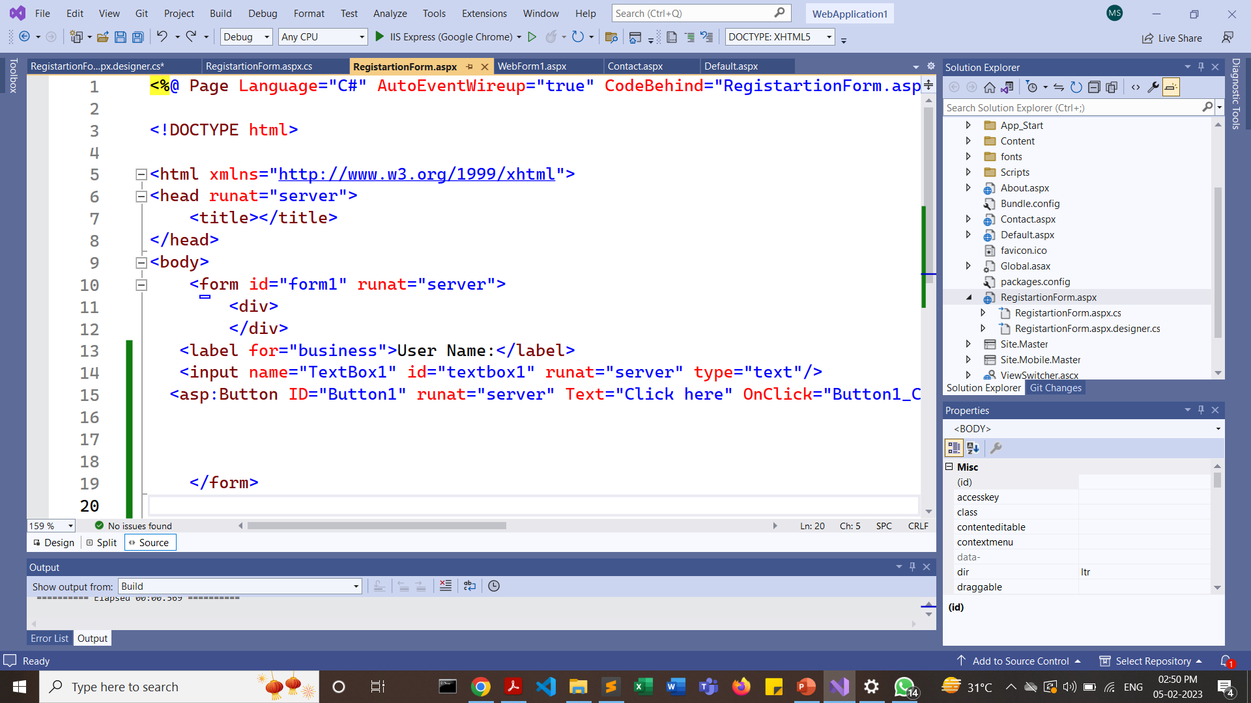

Slide 38
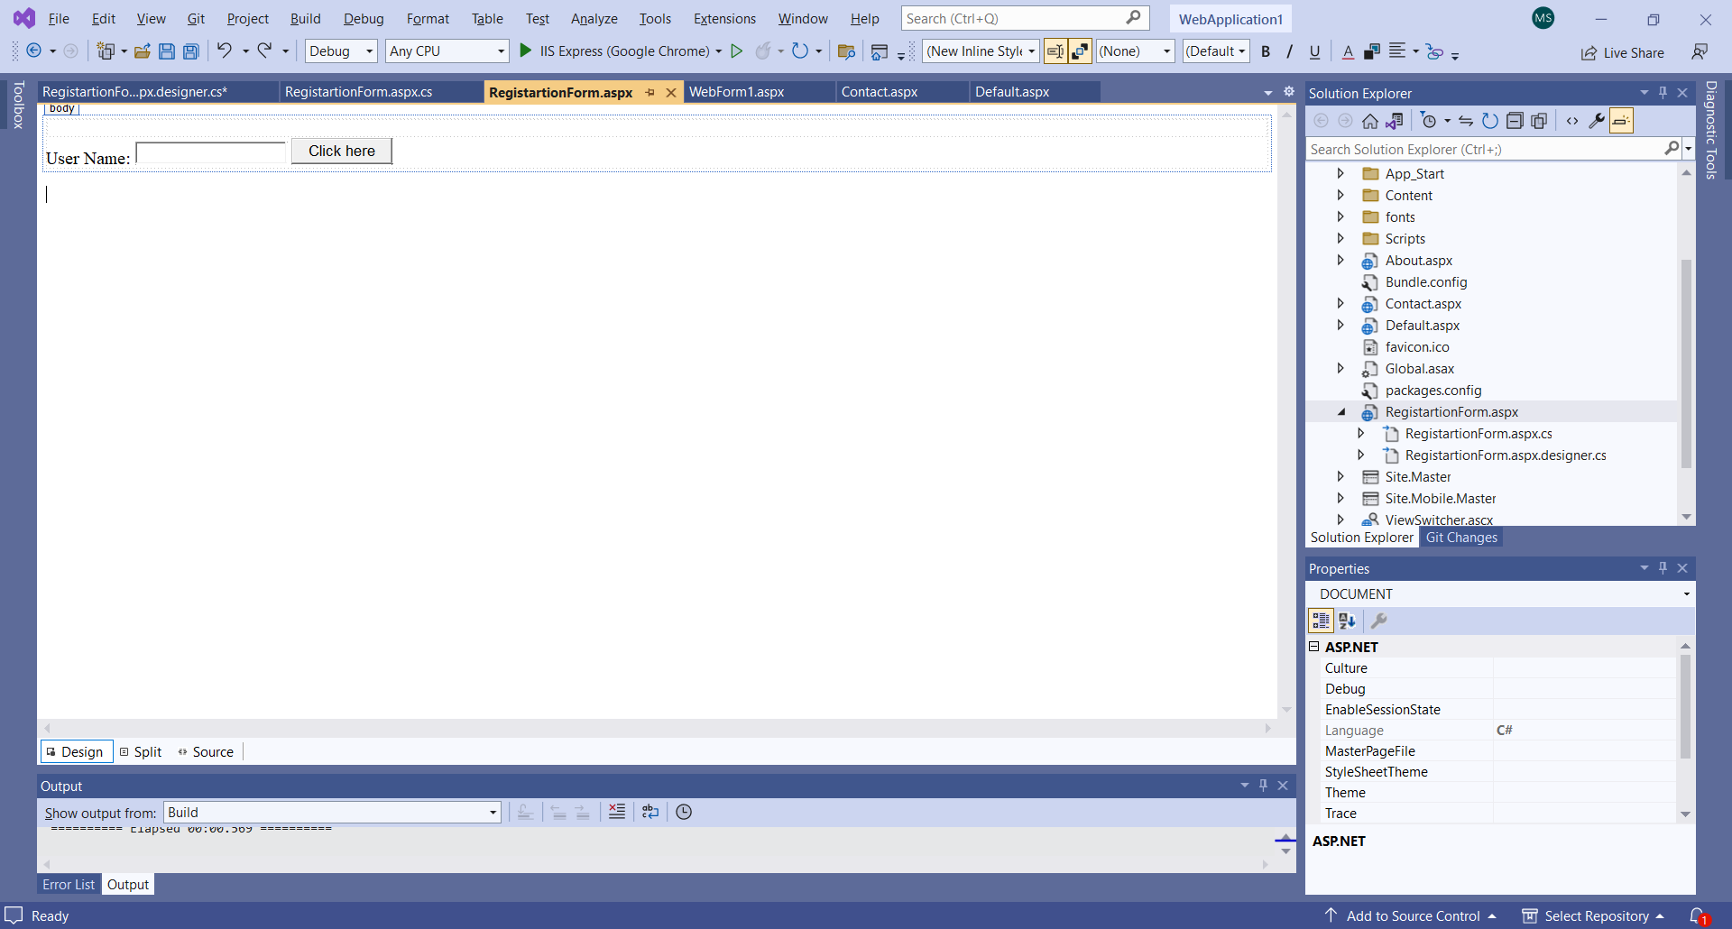
Design View

Slide 39
As we create a web form, .NET creates .aspx and .aspx.cs files
namespace WebApplication1
{
public partial class RegistartionForm : System.Web.UI.Page
{
protected void Page_Load(object sender, EventArgs e)
{
}
protected void Button1_Click(object sender, EventArgs e)
{
string a = Request.Form["textbox1"];
Response.Write("Hello"+a);
}
}
}
Here, we have written Button_Click1() event handler

Slide 40
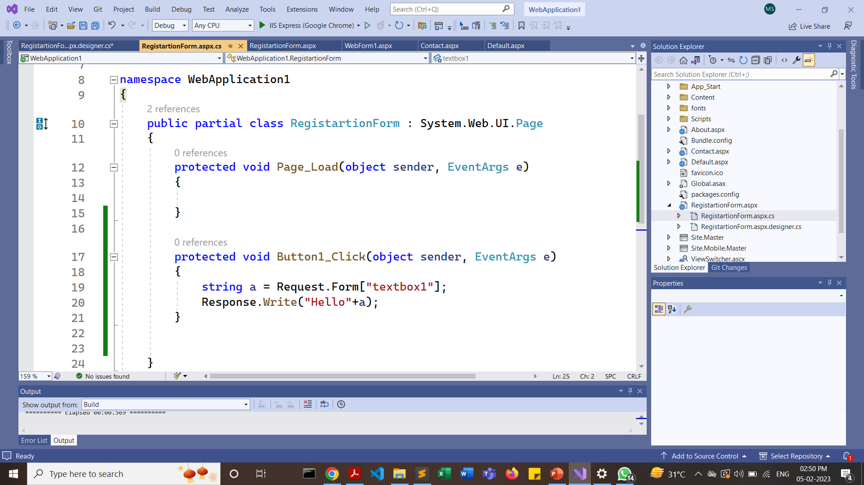

Slide 41
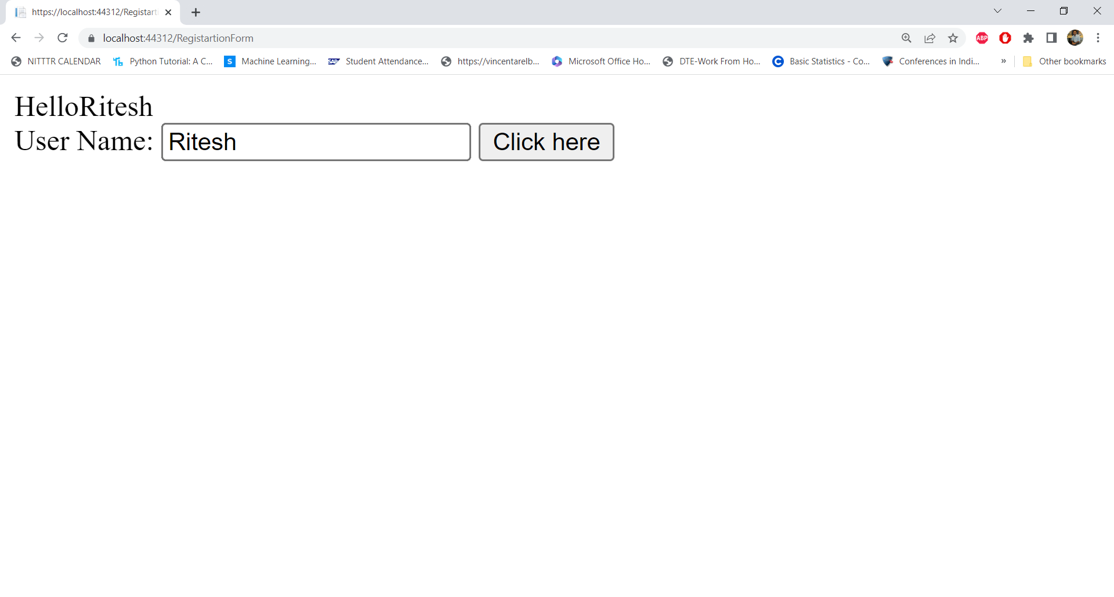

Slide 42
https://www.c-sharpcorner.com/UploadFile/0c1bb2/Asp-Net-form-validation-using-javascript/
https://www.codeproject.com/Tips/404274/Client-Side-Validation-using-JavaScript

Slide 43
<body>
<form id="form1" runat="server">
<table>
<tr>
<td>Name
</td>
</tr>
<tr>
<td>
<asp:TextBox ID="txtName" runat="server" ClientIDMode="Static" ></asp:TextBox>
</td>
</tr>
<tr>
<td>Email
</td>
</tr>
<tr>
<td>
<asp:TextBox name="email" ID="EmailID" runat="server"></asp:TextBox>
</td>
</tr>

Slide 44
<tr>
<td>Cell No.
</td>
</tr>
<tr>
<td>
<asp:TextBox name="contact" ID="txtCell" runat="server" MaxLength="10" onkeypress="return OnlyNumbers(event)" ></asp:TextBox>
</td>
</tr>
<tr>
<td>
<asp:Button ID="BtnSubmit" Text="Submit" runat="server" OnClick="BtnSubmit_Click" OnClientClick="return chkvalidation()" />
</td>
</tr>
</table>
</form>

Slide 45
function OnlyNumbers()
{
var digits = "0123456789";
var temp;
var len = document.getElementById("<%=txtCell.ClientID %>").value.length;
for (var i = 0; i < len; i++)
{
temp = document.getElementById("<%=txtCell.ClientID%>").value.substring(i, i + 1);
if (digits.indexOf(temp) == -1)
{
alert("Please enter correct pin code");
document.getElementById("<%=txtCell.ClientID%>").focus();
return false;
}
}
return true;
}

Slide 46
function chkvalidation() {
// introduce validation code for controls here
var name = document.getElementById("<%= txtName.ClientID %>").value;
if (name.length == 0)
{
//alert(name);
alert("Name field should not be empty");
return false;
}
var email = document.getElementById("<%= EmailID.ClientID %>").value;
//alert(email);
if (email == "")
{
alert("Email field should not be empty");
return false;
}
// You can code for other controls
return true;
}

Slide 47
protected void BtnSubmit_Click(object sender, EventArgs e)
{
string a = Request.Form["txtName"];
Response.Write("Hello" + a);
}

Slide 48
REGEX SYMBOLS
Symbol | Meaning
* | for 0 or more times (upto infinite)
+ | at atleast one or more times(up to infinite).
{ } | for as many times as the value inside this bracket.
. | can take the place of any other symbol(wild card)
^ | the match must start at the beginning of the string or line.
[^chars] | Matches any single character that is not in set_of_characters
$ | the match must occur at the end of the string or before \n at the end of the line or string.
\ | to match for the actual ‘+’, ‘.’ etc characters, add a backslash (\ ) before that character Example: \d+[\+-x\*]\d+ will match patterns like "2+2" and "3*9" in "(2+2) * 3*9"
| | Matches any one element separated by the vertical bar (|) character
https://www.geeksforgeeks.org/write-regular-expressions/

Slide 49
REGEX SYMBOLS
\s: matches any whitespace characters such as space and tab.
\S: matches any non-whitespace characters.
\d: matches any digit character.
\D: matches any non-digit characters.
\w : matches any word character (basically alpha-numeric)
\W: matches any non-word character.
\b: matches any word boundary (this would include spaces, dashes, commas, semi-colons, etc.
[set_of_characters]: Matches any single character in set_of_characters. By default, the match is case-sensitive.
https://www.geeksforgeeks.org/write-regular-expressions/

Slide 50
function chkEmail()
{
var email = document.getElementById("<%= EmailID.ClientID %>").value;
var emailExp = /^([a-zA-Z0-9_\.\-])+\@(([a-zA-Z0-9\-])+\.)+([com\co\.\in])+$/;
if (!email.match(emailExp))
{
alert("Invalid Email Id");
return false;
}
}
/^([a-zA-Z0-9_\.\-])+\@(([a-zA-Z0-9\-])+\.)+([com\co\.\in])+$/;
OR
/^([a-zA-Z0-9_\.\-])+\@(([a-zA-Z0-9\-])+\.)+([a-zA-Z]{2,5})+$/;

Slide 51
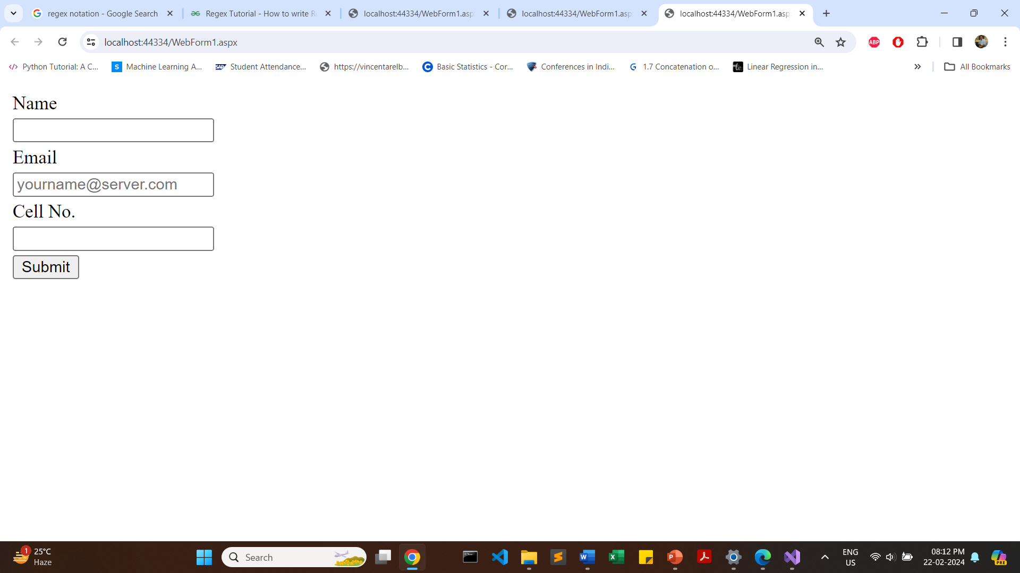

Slide 52
ASP.NET WEB Controls & Client Side Validation using Java Script
<body>
<form id="form1" runat="server">
<div>
<table>
<tr>
<td>Name
</td>
<td>
<asp:TextBox ID="txtName" runat="server" ClientIDMode="Static" ></asp:TextBox>
</td>
</tr>
<tr>
<td>Age
</td>
<td>
<asp:TextBox ID="txtAge" runat="server" MaxLength="3" ></asp:TextBox>
</td>
</tr>

Slide 53
ASP.NET WEB Controls & Client Side Validation using Java Script
<tr>
<td>Mobile
</td>
<td>
<asp:TextBox ID="txtMobile" runat="server" MaxLength="10" onkeypress="return OnlyNumbers(event)" ></asp:TextBox>
</td>
</tr>
<tr>
<td>Email ID
</td>
<td>
<asp:TextBox ID="txtEmailID" runat="server" placeholder="yourname@server.com" onblur="checkEmail(this)"></asp:TextBox>
</td>
</tr>
<tr>
<td rowspan="1">
<asp:Button ID="BtnSubmit" Text="Submit" runat="server" OnClick="BtnSubmit_Click" OnClientClick="return chkvalidation()" />
</td>
</tr>
</table>
</div>
</form>
</body>
</html>

Slide 54
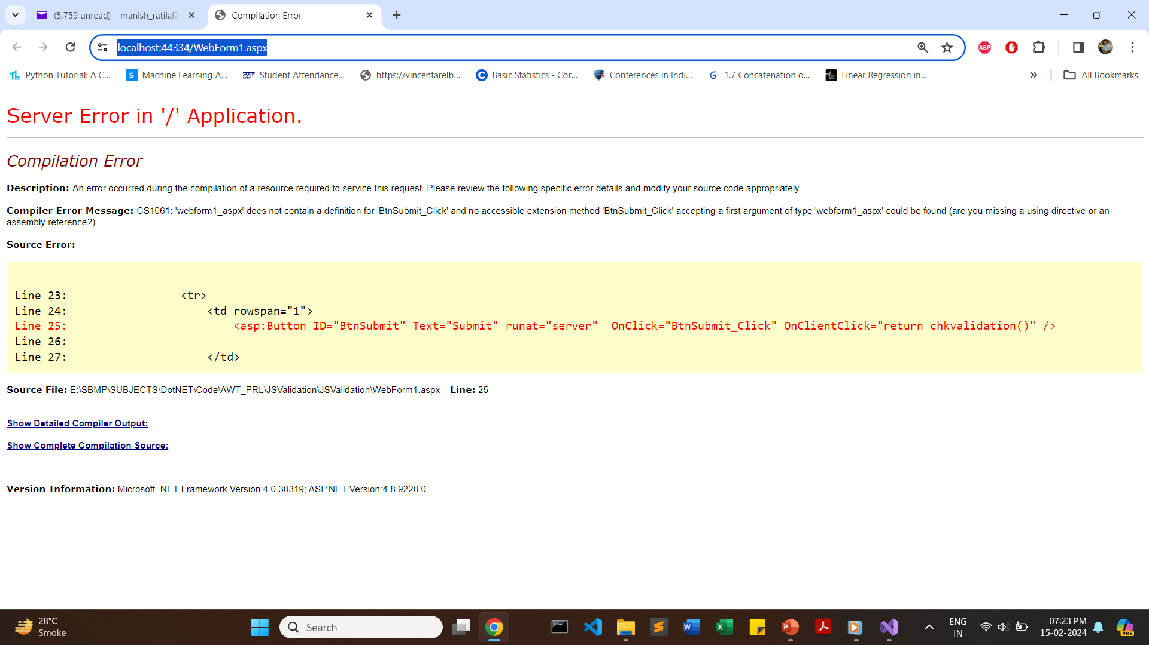
NOTE: At first double click on the button in design mode and then only run the web form

Slide 55
Java Script Code
<html xmlns="http://www.w3.org/1999/xhtml">
<head runat="server">
<title></title>
<script>
function chkvalidation() {
// introduce validation code for controls here
var name = document.getElementById("<%= txtName.ClientID %>").value;
if (name.length > 0)
{
//alert(name);
return true;
}
// You can code for other controls
return false;
}
</script>
</head>

Slide 56
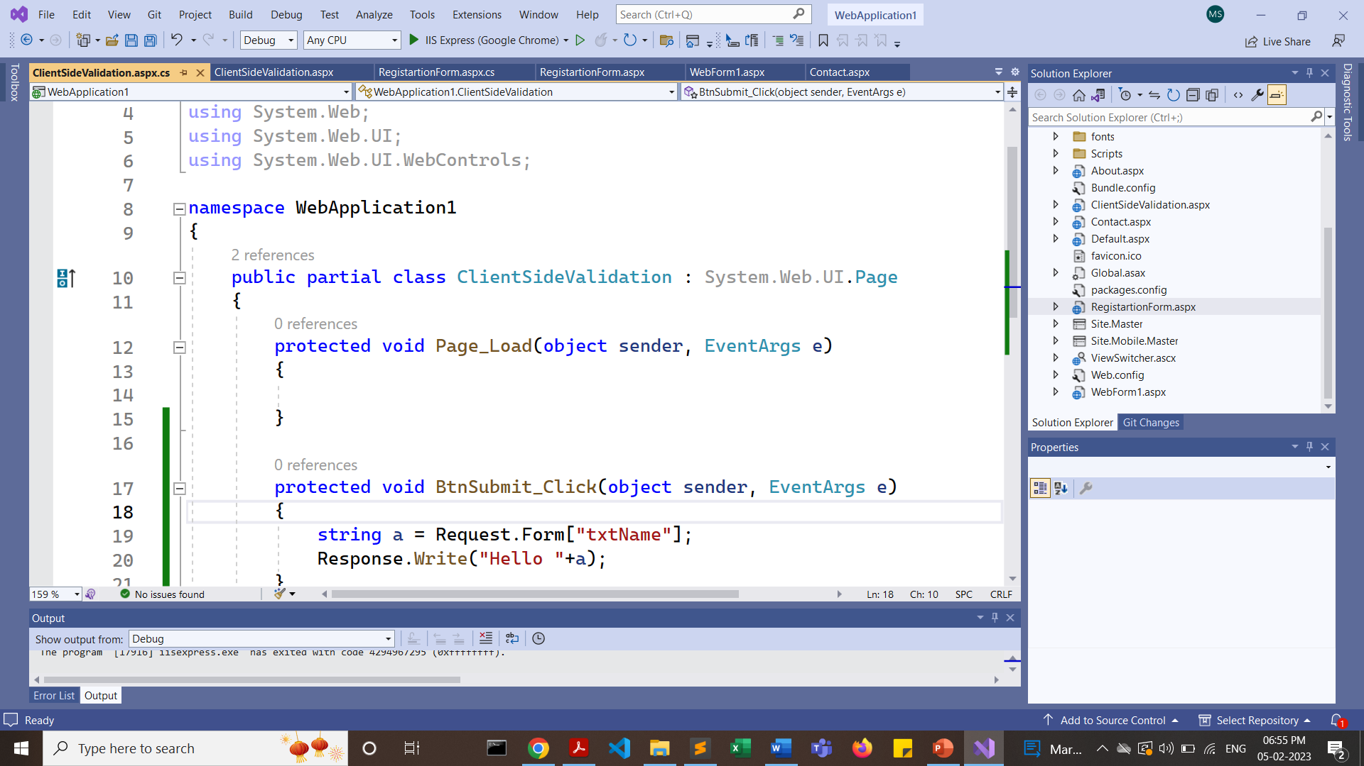

Slide 57
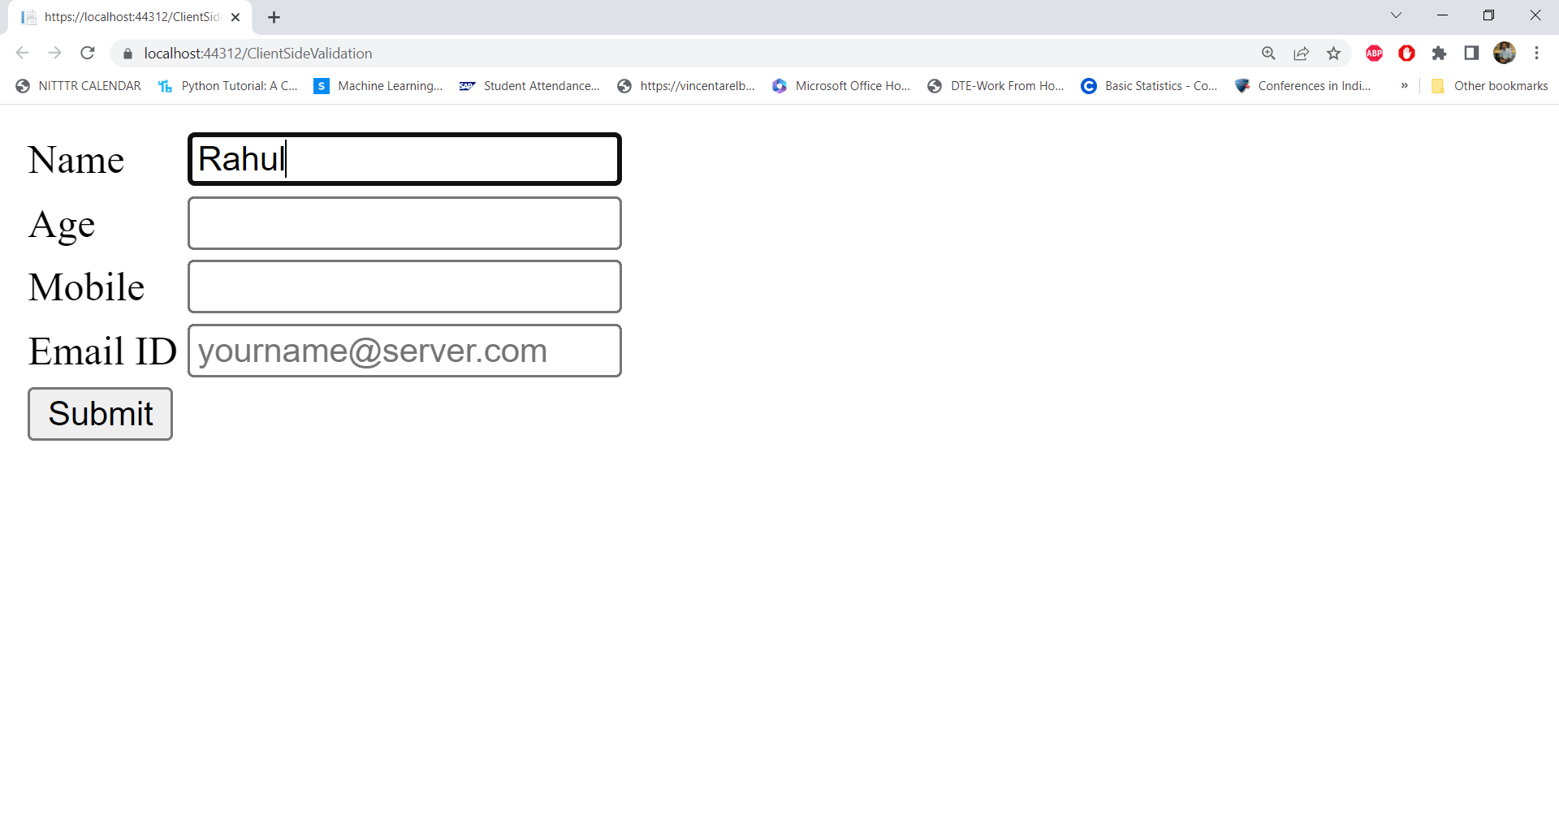
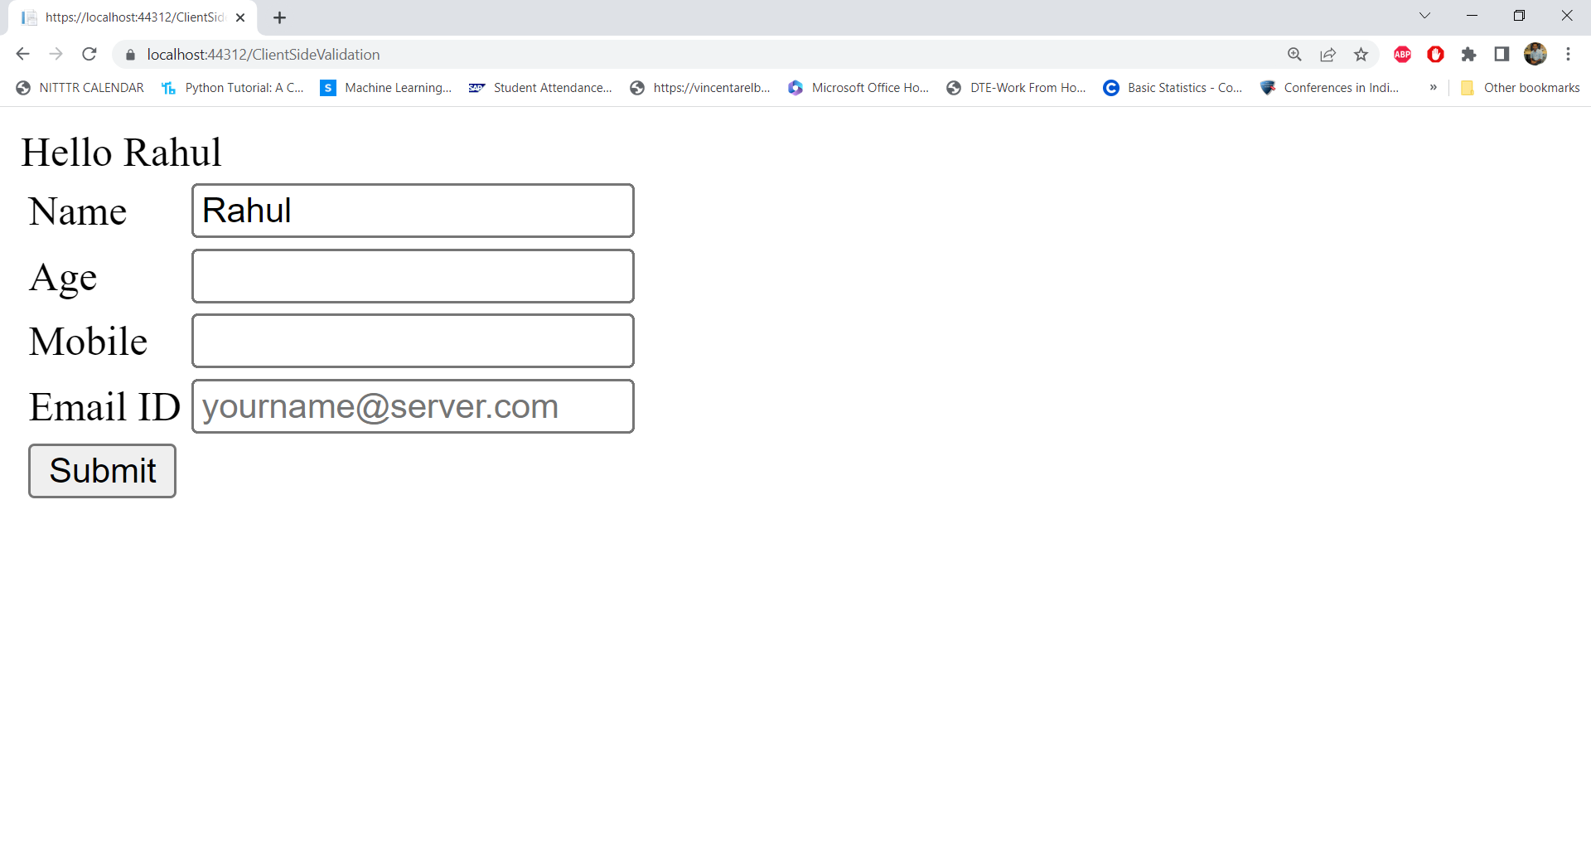
https://www.c-sharpcorner.com/article/textbox-validation-client-side-and-server-side-in-asp-net-webform/

Slide 58
ASP.NET Validators

Slide 59
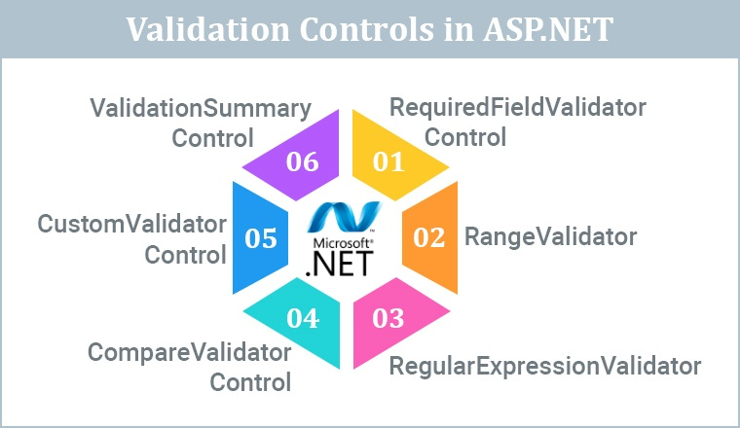
https://www.tatvasoft.com/outsourcing/2022/09/validation-in-asp-net.html

Slide 60
Why do we need Validation?
Preventing invalid data from being submitted: Validation controls can check for required fields, format and type of data, and other criteria that must be met before the data can be submitted to the server. This helps ensure that the data is accurate and complete and that the application can process it correctly.
Improving user experience: When users enter invalid data, they may receive error messages or other feedback that helps them correct their mistakes. This can help prevent frustration and improve the overall user experience.
Enhancing security: Validation controls can help prevent malicious code or other attacks that could harm the web application or its users. For example, validation controls can check for potentially dangerous input such as SQL injection or cross-site scripting (XSS) attacks.
Meeting business requirements: Many businesses have specific rules and requirements for data entry, such as a minimum or a maximum number of characters or certain formatting conventions. Validation controls can help ensure that these requirements are met.
https://www.c-sharpcorner.com/UploadFile/puranindia/validation-controls-in-Asp-Net/

Slide 61
ASP.NET Validators
To perform validation, ASP.NET provides controls that automatically check user input and require no code. We can also create custom validation for our application.
Validator | Description
CompareValidator | It is used to compare the value of an input control against a value of another input control. Password: Confirm Password:
RangeValidator | It evaluates the value of an input control to check the specified range. Sem 1-8, Age: 14-18
RegularExpressionValidator | It evaluates the value of an input control to determine whether it matches a pattern defined by a regular expression. Email, passwords
RequiredFieldValidator | It is used to make a control required. In Every control * Required Field
ValidationSummary | It displays a list of all validation errors on the Web page.

Slide 62
Validation Control | Description
RequiredFieldValidation | Ensures that a field is not left empty or blank. It can be used for textboxes, dropdown lists, checkboxes, and other input controls.
CompareValidator | This control compares the value of one input control to another. It can validate passwords, confirm email addresses, and other scenarios where two values must match.
RangeValidator | This control checks if a value falls within a specific range. For example, it can be used to validate a user's age, income, or date of birth.
RegularExpressionValidator | This control checks if a value matches a specified regular expression pattern. For example, it can validate email addresses, phone numbers, zip codes, and other input types.
CustomValidator | This control allows developers to define their validation logic. It usually depends on the business rules.
ValidationSummary | This control displays a report of all validation errors that occurred on a Web page.
https://www.c-sharpcorner.com/UploadFile/puranindia/validation-controls-in-Asp-Net/

Slide 63
ASP.NET Validators
1. RequiredFieldValidator
Indicates the input Control is not empty when the form is submitted.
Syntax
<asp:RequiredFieldValidator ID="someUniqueId"
runat="server" ControlToValidate ="someUniqueControlId"
ErrorMessage="ErrorToDisplayOnValidationFailure"
InitialValue="aPlaceholderValue">
</asp:RequiredFieldValidator>
ControlToValidate= id of control we want to monitor/validate
NOTE: In DropDown List, InitialValue attribute should be written before ErrorMessage attribute

Slide 64
ASP.NET Validators
2. RangeValidator
The Rangevalidator control verifies that the input value falls within a given range of number, date or string.
Syntax
<asp:RangeValidator ID="some unique id"
runat="server" ControlToValidate ="someUniqueControlId"
ErrorMessage="ErrorToDisplayOnValidationFailure"
Type="Integer" MinimumValue=”0” MaximumValue=”100”>
</asp:RangeValidator>

Slide 65
ASP.NET Validators
3. RegularExpressionValidator
The RegularExpressionValidator control validates the input text of a control that matches a pattern defined by a RegularExpression.
Syntax
<asp:RegularExpressionValidator ID="someUniqueId"
runat="server" ControlToValidate ="someUniqueControlId"
ErrorMessage="ErrorToDisplayOnValidationFailure"
ValidationExpression=”aRegexPattern”>
</asp:RegularExpressionValidator>

Slide 66
ASP.NET Validators
4. CompareValidator
The Comaprevalidator control compares the value of one control to another using a comparison operator.
Syntax
<asp:CompareValidator ID="someUniqueId"
runat="server" ControlToValidate ="someUniqueControlId"
ErrorMessage="ErrorToDisplayOnValidationFailure"
Type="string" ControlToCompare=”ControlToValidateIdOfAnotherControl”
ValueToCompare=”aFixedValue” Operator=”Equal”>
</asp:CompareValidator>

Slide 67
ASP.NET Validators
5. CustomValidator
ASP.Net also allows the freedom of writing your own validator. This eases the task of a developer to validate the form at the client side itself. It also allows putting more complex validations in place. Validations that are business or application-specific can be written using custom validators.
Syntax
<asp:CustomValidator ID="someUniqueId"
runat="server" ControlToValidate ="someUniqueControlId"
ErrorMessage="ErrorToDisplayOnValidationFailure"
ClientValidationFunction=”functionName”>
</asp:CustomValidator>

Slide 68
ASP.NET Validators
6. ValidationSummary
The ValidationSummary control doesn’t perform any validation. Instead, it shows a summary of errors raised by each control on the page.
Syntax
<asp:ValidationSummary ID="ValidationSummaryControl"
runat="server" DisplayMode=”BulletList” ShowSummary=”true”
HeaderText=”List of Errors” />
Reference -> https://rlogicaltech.medium.com/what-are-asp-net-validators-7990b53aaead

Slide 69
<%@ Page Language="C#" AutoEventWireup="true" CodeBehind="Validators.aspx.cs" Inherits="WebApplication1.WebForm2" %>
<!DOCTYPE html>
<html xmlns="http://www.w3.org/1999/xhtml">
<head runat="server">
<title></title>
</head>
<body>
<form id="form1" runat="server">
<table style="width: 66%;">
<tr>
<td class="style1" colspan="3" align="center">
<asp:Label ID="lblmsg"
Text="President Election Form : Choose your president"
runat="server" />
</td>
</tr>
<tr>
<td class="style3">
Candidate:
</td>
<td class="style2">
<asp:DropDownList ID="ddlcandidate" runat="server" style="width:239px">
<asp:ListItem>Please choose a candidate</asp:ListItem>
<asp:ListItem>M H Kabir</asp:ListItem>
<asp:ListItem>Steve Taylor</asp:ListItem>
<asp:ListItem>John Abraham</asp:ListItem>
<asp:ListItem>Venus Williams</asp:ListItem>
</asp:DropDownList>
</td>

Slide 70
<td>
<asp:RequiredFieldValidator ID="rfvcandidate"
runat="server" ControlToValidate ="ddlcandidate"
InitialValue="Please choose a candidate"
ErrorMessage="Please choose a candidate"
ForeColor="Red">
</asp:RequiredFieldValidator>
</td>
</tr>
<tr>
<td class="style3">
House:
</td>
<td class="style2">
<asp:RadioButtonList ID="rblhouse" runat="server" RepeatLayout="Flow">
<asp:ListItem>Red</asp:ListItem>
<asp:ListItem>Blue</asp:ListItem>
<asp:ListItem>Yellow</asp:ListItem>
<asp:ListItem>Green</asp:ListItem>
</asp:RadioButtonList>
</td>

Slide 71
<td>
<asp:RequiredFieldValidator ID="rfvhouse" runat="server"
ControlToValidate="rblhouse" ErrorMessage="Enter your house name" ForeColor="Red" >
</asp:RequiredFieldValidator>
<br />
</td>
</tr>
<tr>
<td class="style3">
Class:
</td>
<td class="style2">
<asp:TextBox ID="txtclass" runat="server"></asp:TextBox>
</td>
<td>
<asp:RangeValidator ID="rvclass"
runat="server" ControlToValidate="txtclass"
ErrorMessage="Enter your class (6 - 12)" MaximumValue="12"
MinimumValue="6" Type="Integer" ForeColor="Red">
</asp:RangeValidator>
</td>
</tr>

Slide 72
<tr>
<td class="style3">
Email:
</td>
<td class="style2">
<asp:TextBox ID="txtemail" runat="server" style="width:250px">
</asp:TextBox>
</td>
<td>
<asp:RegularExpressionValidator ID="remail" runat="server"
ControlToValidate="txtemail" ErrorMessage="Enter your email"
ForeColor="Red" ValidationExpression="\w+([-+.']\w+)*@\w+([-.]\w+)*\.\w+([-.]\w+)*">
</asp:RegularExpressionValidator>
</td>
</tr>
<tr>
<td class="style3" align="center" colspan="3">
<asp:Button ID="BtnSubmit" runat="server" onclick="BtnSubmit_Click"
style="text-align: center" Text="Submit" />
</td>
</tr>
</table>
<asp:ValidationSummary ID="ValidationSummary1" runat="server"
DisplayMode ="BulletList" ShowSummary ="true" HeaderText="Errors:" ForeColor="Red" />
</form>
</body>
</html>

Slide 73
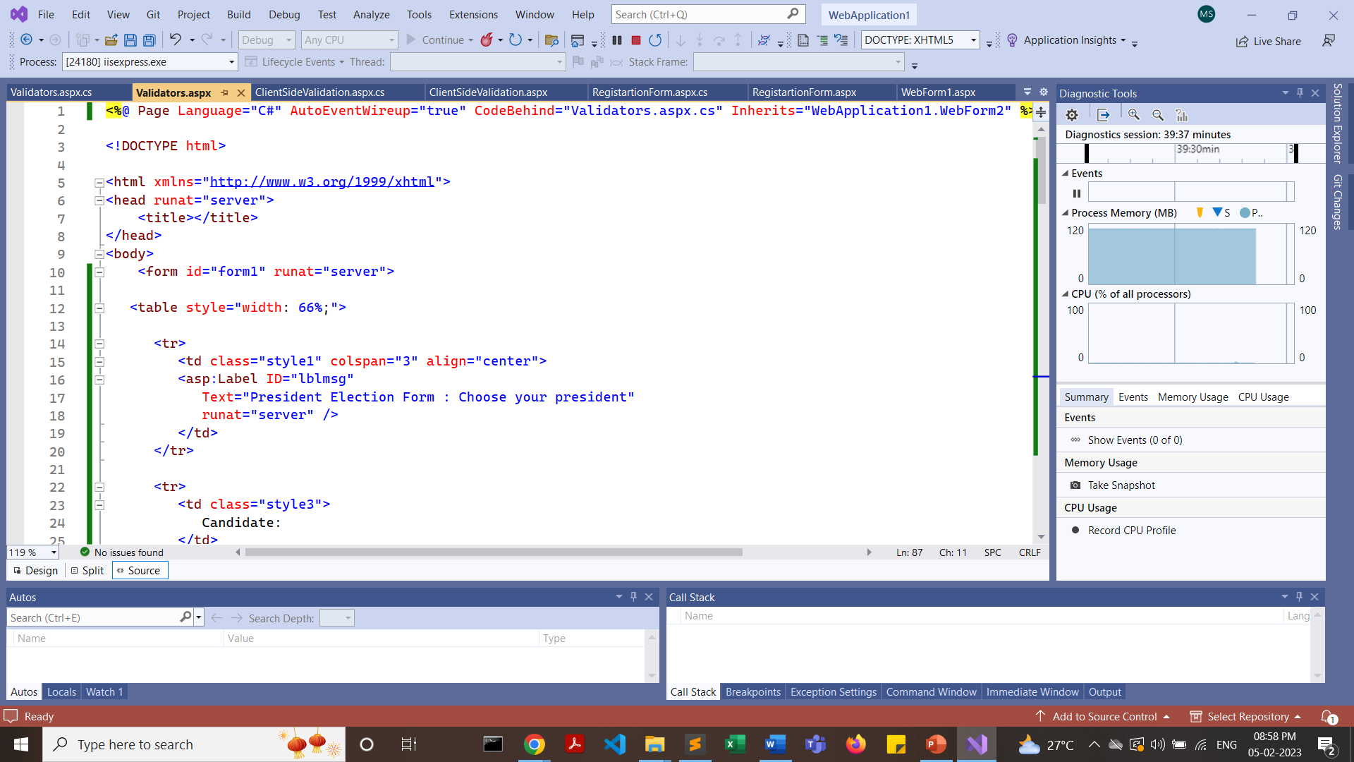

Slide 74
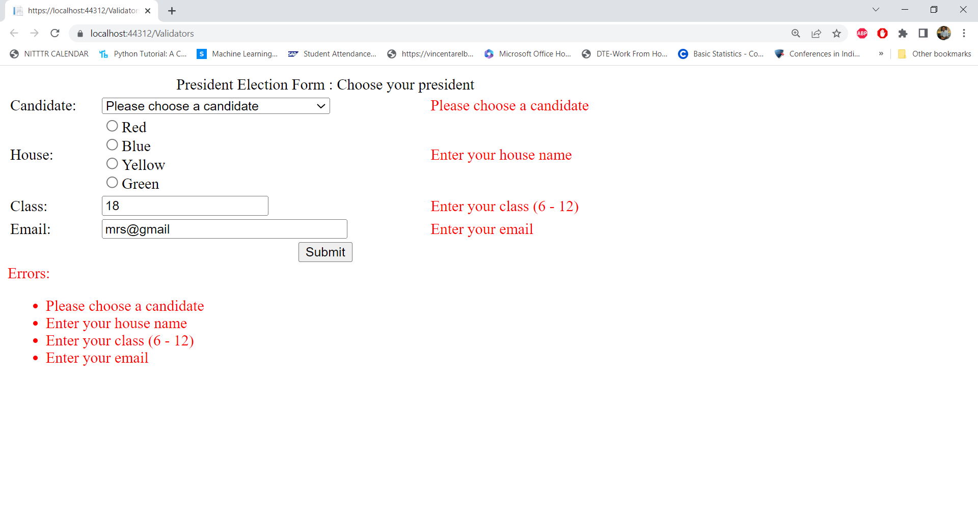
https://www.tutorialspoint.com/asp.net/asp.net_validators.htm

Slide 75
#ControlToValidate property is mandatory for all validate controls #One validation control will validate only one input control, but multiple validation control can be assigned to the input control.

Slide 76
Another Application

Slide 77
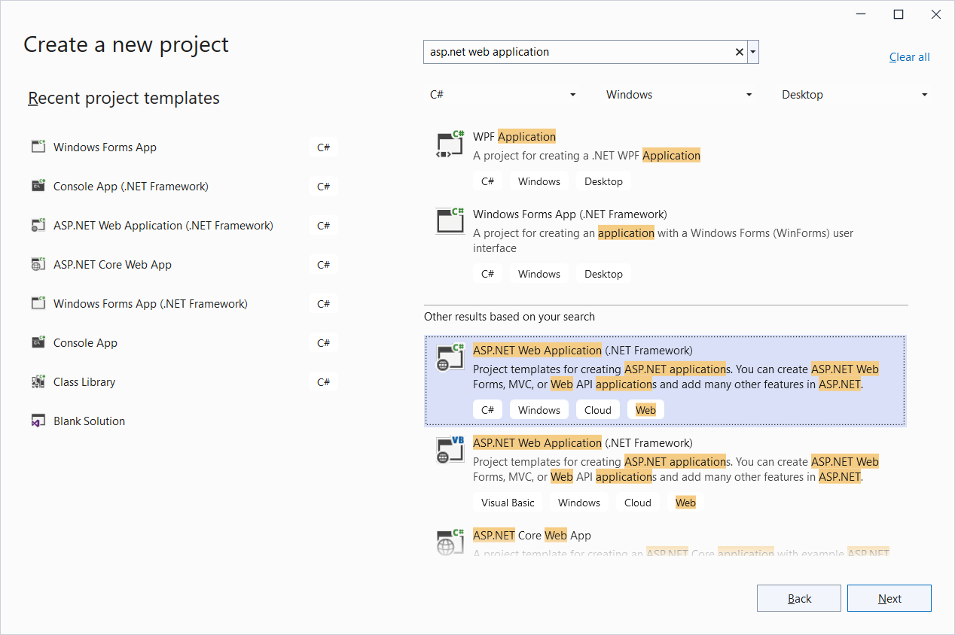

Slide 78
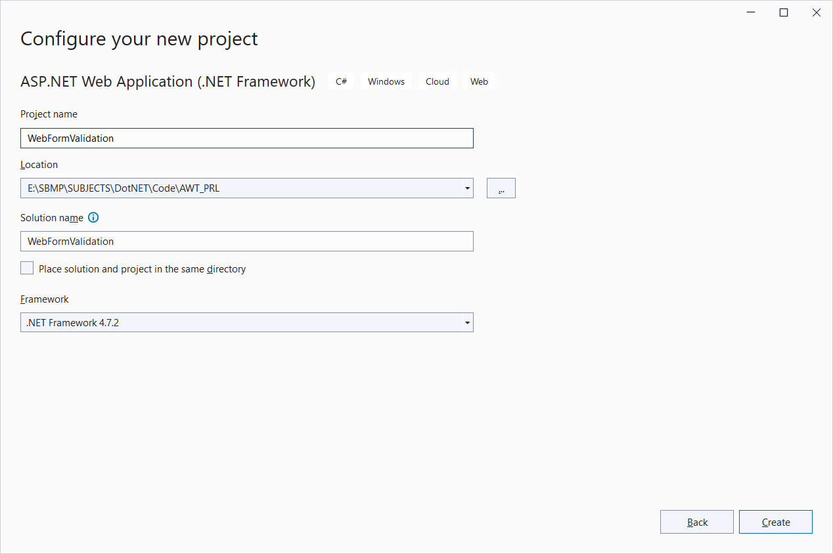

Slide 79
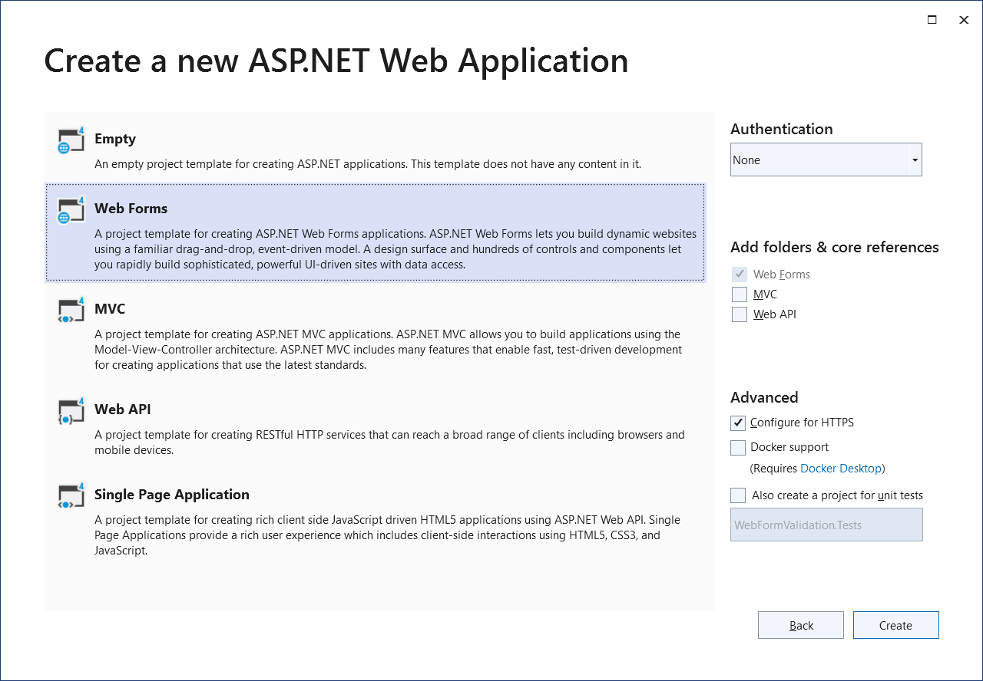

Slide 80
Default.aspx code
<%@ Page Language="C#" AutoEventWireup="true" CodeFile="Default.aspx.cs" Inherits=“namespace._Default" %>
<!DOCTYPE html PUBLIC "-//W3C//DTD XHTML 1.0 Transitional//EN" "http://www.w3.org/TR/xhtml1/DTD/xhtml1-transitional.dtd">
<html xmlns="http://www.w3.org/1999/xhtml">
<head runat="server">
<title>Untitled Page</title>
</head>
<body>
<form id="form1" runat="server">
<div>
<asp:Label ID="Label3" runat="server" Style="top: 241px; left: 70px; position: absolute;
height: 22px; width: 128px; bottom: 282px;" Text="Enter your email id:"></asp:Label>
<asp:Label ID="Label1" runat="server" Style="top: 54px; left: 74px; position: absolute;
height: 22px; width: 128px" Text="Enter your name:"></asp:Label>
<asp:TextBox ID="TextBox1" runat="server" Style="top: 54px; left: 221px; position: absolute;
height: 22px; width: 128px; right: 396px;"></asp:TextBox>
<asp:RequiredFieldValidator ID="RequiredFieldValidator1" runat="server" Style="top: 56px;
left: 378px; position: absolute; height: 22px; width: 128px" ErrorMessage="RequiredFieldValidator"
ControlToValidate="TextBox1">name is
mandatory </asp:RequiredFieldValidator>
</div>

Slide 81
<p>
<asp:Button ID="Button1" runat="server" Style="top: 311px; left: 267px; position: absolute;
height: 26px; width: 61px" Text="Submit" />
</p>
<asp:TextBox ID="TextBox3" runat="server" Style="top: 145px; left: 217px; position: absolute;
height: 22px; width: 131px" TextMode="Password"></asp:TextBox>
<p>
<asp:TextBox ID="TextBox2" runat="server" Style="top: 101px; left: 218px; position: absolute;
height: 22px; width: 131px" TextMode="Password"></asp:TextBox>
<asp:Label ID="Label4" runat="server" Style="top: 105px; left: 74px; position: absolute;
height: 22px; width: 128px" Text="Password"></asp:Label>
<asp:TextBox ID="TextBox5" runat="server" Style="top: 239px; left: 210px; position: absolute;
height: 22px; width: 134px"></asp:TextBox>
</p>
<asp:RequiredFieldValidator ID="RequiredFieldValidator3" runat="server" Style="top: 98px;
left: 367px; position: absolute; height: 26px; width: 162px" ErrorMessage="password required"
ControlToValidate="TextBox2"></asp:RequiredFieldValidator>
<asp:RequiredFieldValidator ID="RequiredFieldValidator2" runat="server" Style="top: 145px;
left: 367px; position: absolute; height: 26px; width: 162px" ErrorMessage="password required"
ControlToValidate="TextBox3"></asp:RequiredFieldValidator>
<asp:CompareValidator ID="CompareValidator1" runat="server" Style="top: 149px; left: 512px;
position: absolute; height: 26px; width: 162px" ErrorMessage="CompareValidator"
ControlToValidate="TextBox3" ValueToCompare="hello"></asp:CompareValidator>

Slide 82
<p>
<asp:Label ID="Label5" runat="server" Style="top: 148px; left: 71px; position: absolute;
height: 22px; width: 128px; bottom: 375px;" Text="Confirm Password"></asp:Label>
<asp:TextBox ID="TextBox4" runat="server" Style="top: 194px; left: 212px; position: absolute;
height: 22px; width: 140px"></asp:TextBox>
<asp:Label ID="Label6" runat="server" Style="top: 194px; left: 71px; position: absolute;
height: 22px; width: 128px; bottom: 329px;" Text="Enter your age:"></asp:Label>
</p>
<asp:RangeValidator ID="RangeValidator1" runat="server" Style="top: 194px; left: 365px;
position: absolute; height: 22px; width: 105px" ErrorMessage="RangeValidator"
ControlToValidate="TextBox4" MaximumValue="100" MinimumValue="18" Type="Integer"></asp:RangeValidator>
<asp:RegularExpressionValidator ID="RegularExpressionValidator1" runat="server" Style="top: 234px;
left: 366px; position: absolute; height: 22px; width: 177px"
ErrorMessage="RegularExpressionValidator" ControlToValidate="TextBox5"
ValidationExpression="\w+([-+.']\w+)*@\w+([-.]\w+)*\.\w+([-.]\w+)*"></asp:RegularExpressionValidator>
</form>
</body>
</html>

Slide 83
<%@ Page Language="C#" AutoEventWireup="true" CodeFile="Default.aspx.cs" Inherits="WebFormValidation._Default" %>
If CodeFile=“Default.aspx.cs” then Inherits property value should be “WebAppName._Default”
Namespace._Default

Slide 84
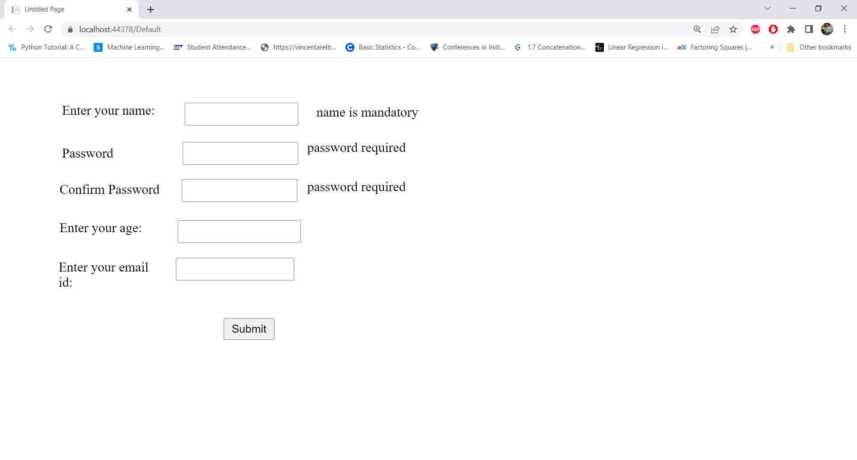

Slide 85
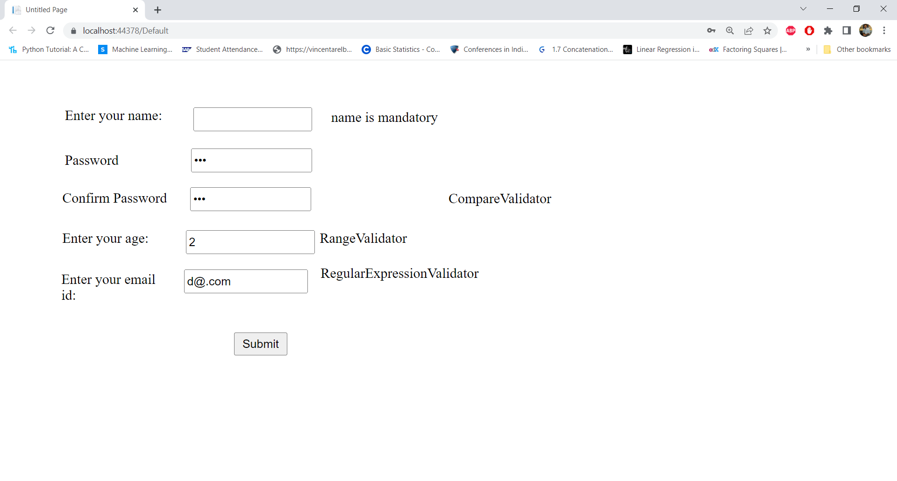

Slide 86
Custom Validator

Slide 87
<%@ Page Language="C#" AutoEventWireup="true" CodeBehind="CustomValidator.aspx.cs" Inherits="WebApplication1.CustomValidator" %>
<!DOCTYPE html>
<html xmlns="http://www.w3.org/1999/xhtml">
<head runat="server">
<title></title>
</head>
<body>
<form id="form1" runat="server">
<div>
<asp:Label ID="Label1" runat="server" Text="User ID:"></asp:Label>
<asp:TextBox ID="TextBox1" runat="server"></asp:TextBox>
<asp:RequiredFieldValidator ID="RequiredFieldValidator1" runat="server"
ControlToValidate="TextBox1" ErrorMessage="User id required"></asp:RequiredFieldValidator>
<asp:CustomValidator ID="CustomValidator1" runat="server" OnServerValidate="UserCustomValidate"
ControlToValidate="TextBox1"
ErrorMessage="User ID should have atleast a capital, small and digit and should be greater than 5 and less
than 26 letters"
SetFocusOnError="True"></asp:CustomValidator>
</div>
<asp:Button ID="Button1" runat="server" OnClick="Button1_Click" Text="Submit"></asp:Button>
</form>
</body>
</html>

Slide 88
protected void UserCustomValidate(object source, ServerValidateEventArgs args)
{
string str = args.Value;
args.IsValid = false;
//checking for input length greater than 6 and less than 25 characters
if (str.Length < 6 || str.Length > 25)
{
return;
}
//checking for a atleast a single capital letter
bool capital = false;
foreach (char ch in str)
{
if (ch >= 'A' && ch <= 'Z')
{
capital = true;
break;
}
}
if (!capital)
{
return;
}

Slide 89
//checking for a atleast a single lower letter
bool lower = false;
foreach (char ch in str)
{
if (ch >= 'a' && ch <= 'z')
{
lower = true;
break;
}
}
if (!lower)
{
return;
}
bool digit = false;
foreach (char ch in str)
{
if (ch >= '0' && ch <= '9')
{
digit = true;
break;
}
}
if (!digit)
{
return;
}
args.IsValid = true;
} //end of UserCustomValidate method

Slide 90
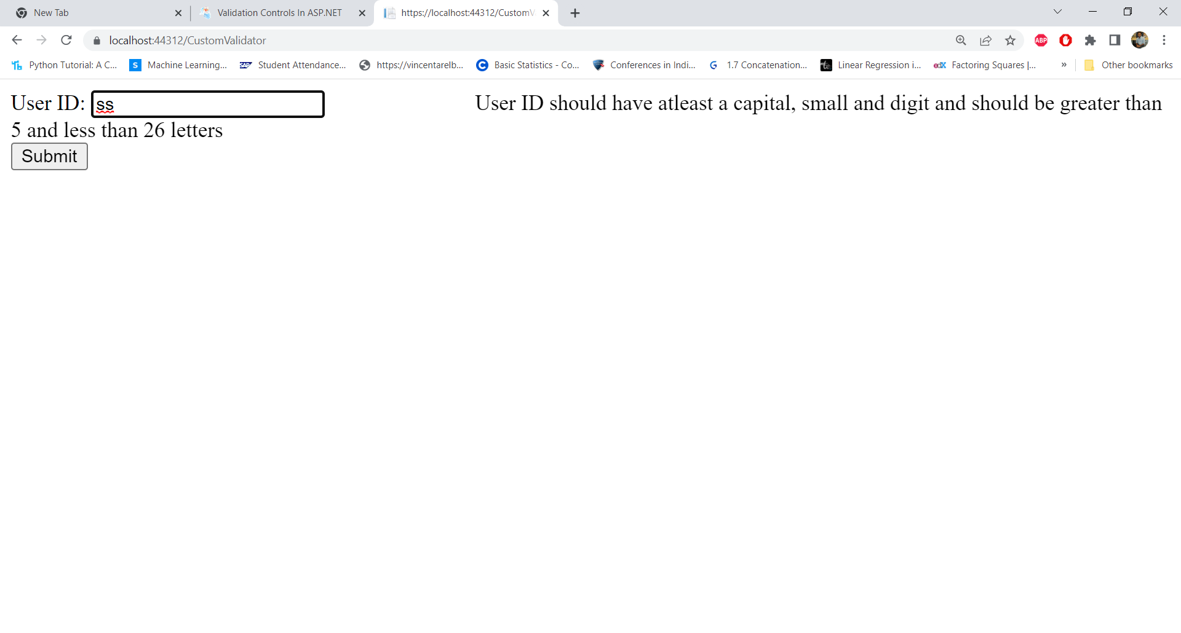

Slide 91
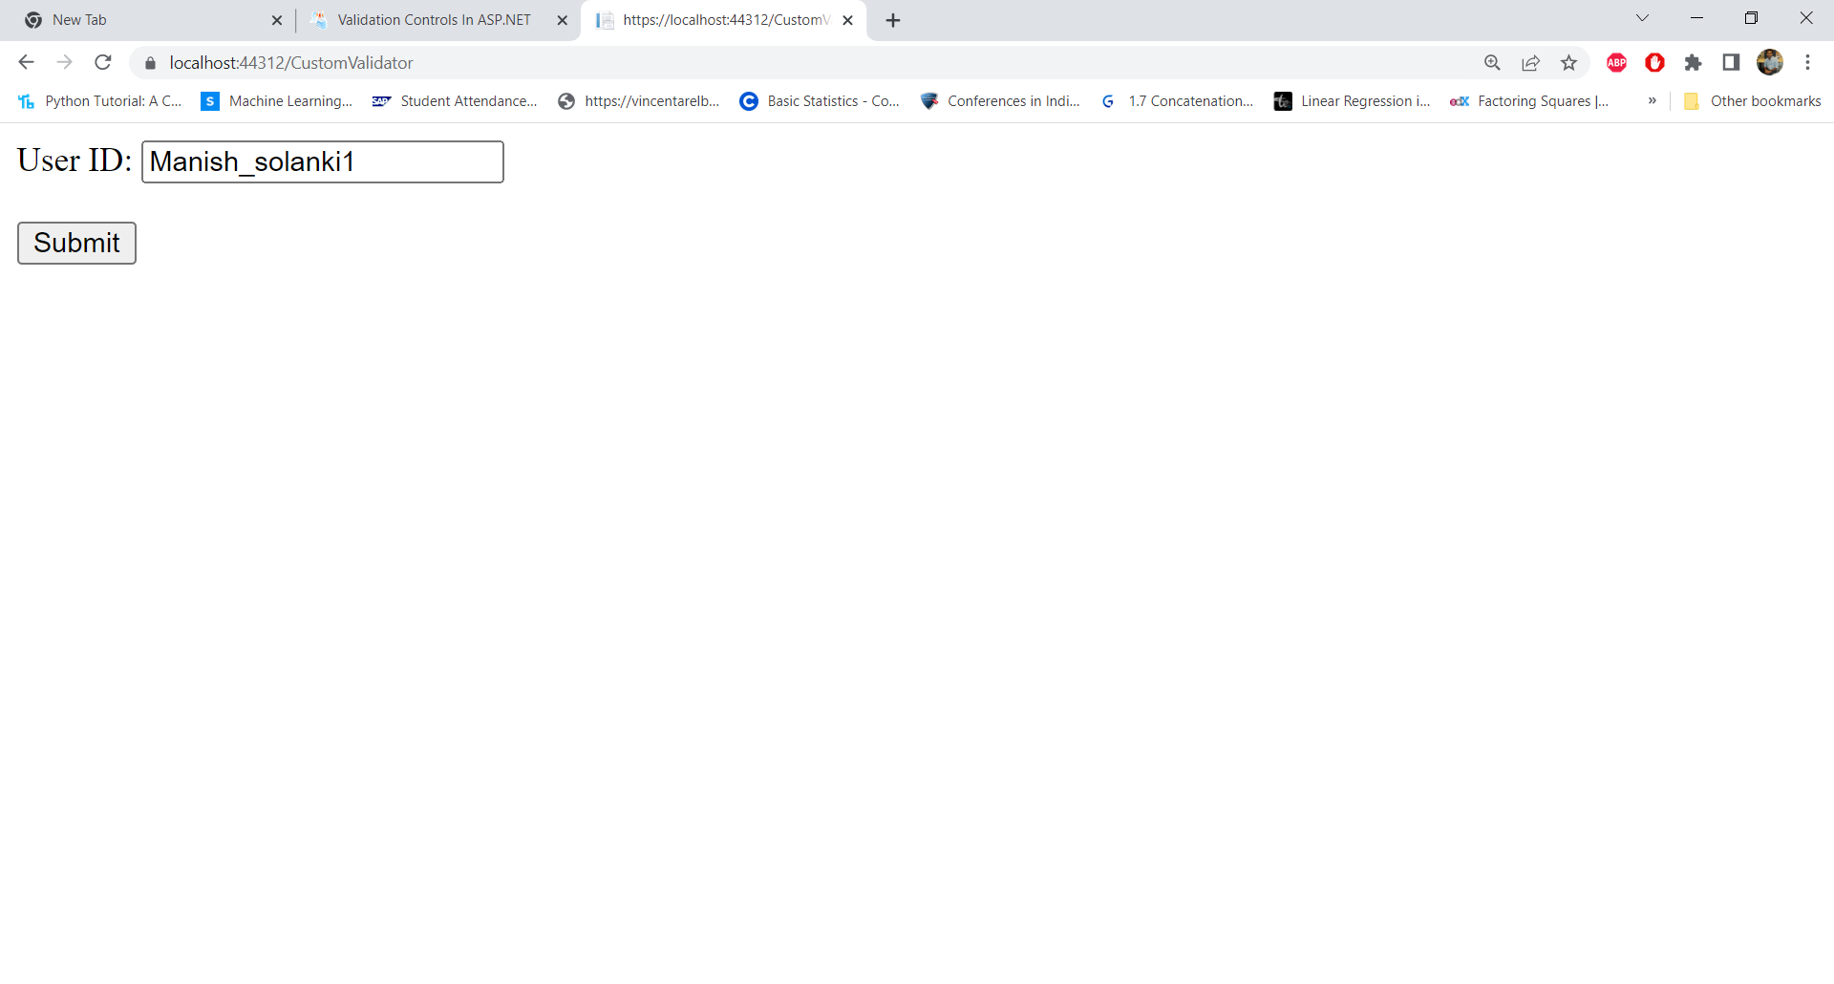

Slide 92
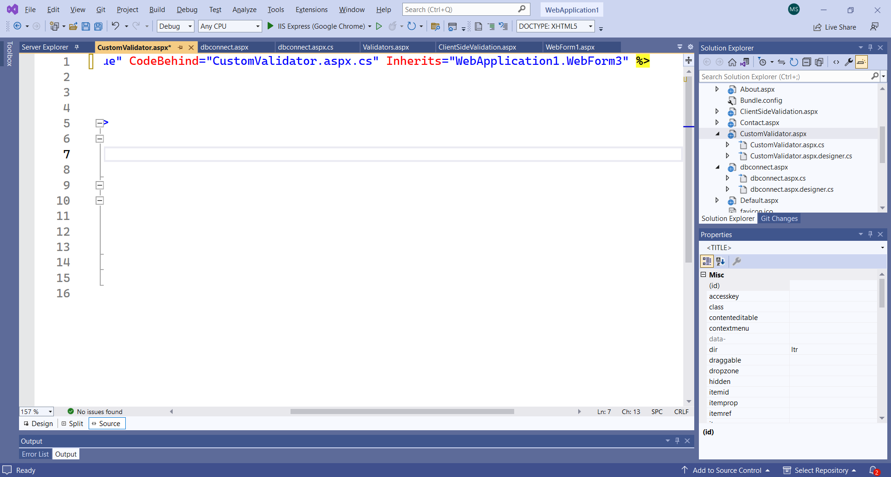
If we rename a WebForm, then changed name is not reflected inside .aspx file. Example: I renamed “WebForm3” to “CustomValidator” but Inherits property has not changed the name as shown below:
So, we have to change it explicitly:
Inherits="WebApplication1.CustomValidator"

Slide 93
We have to change the class name in .cs file as well
using System;
using System.Collections.Generic;
using System.Linq;
using System.Web;
using System.Web.UI;
using System.Web.UI.WebControls;
namespace WebApplication1
{
public partial class WebForm3 : System.Web.UI.Page
{
protected void Page_Load(object sender, EventArgs e)
{
}
}
}

Slide 94
We have to change the class name in .cs file as well
using System;
using System.Collections.Generic;
using System.Linq;
using System.Web;
using System.Web.UI;
using System.Web.UI.WebControls;
namespace WebApplication1
{
public partial class CustomValidator : System.Web.UI.Page
{
protected void Page_Load(object sender, EventArgs e)
{
}
}
}

Slide 95
Form Authentication

Slide 96
Create a new “Web application” Project i.e. “FormAuthentication” and select Empty Template

Slide 97
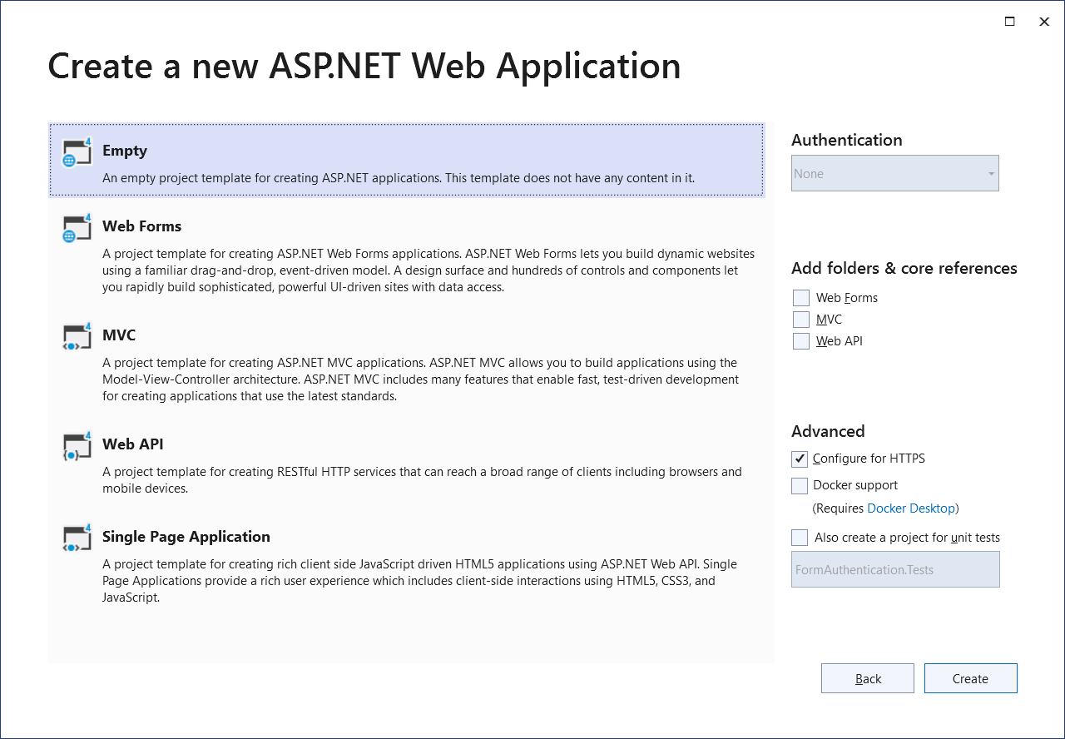

Slide 98
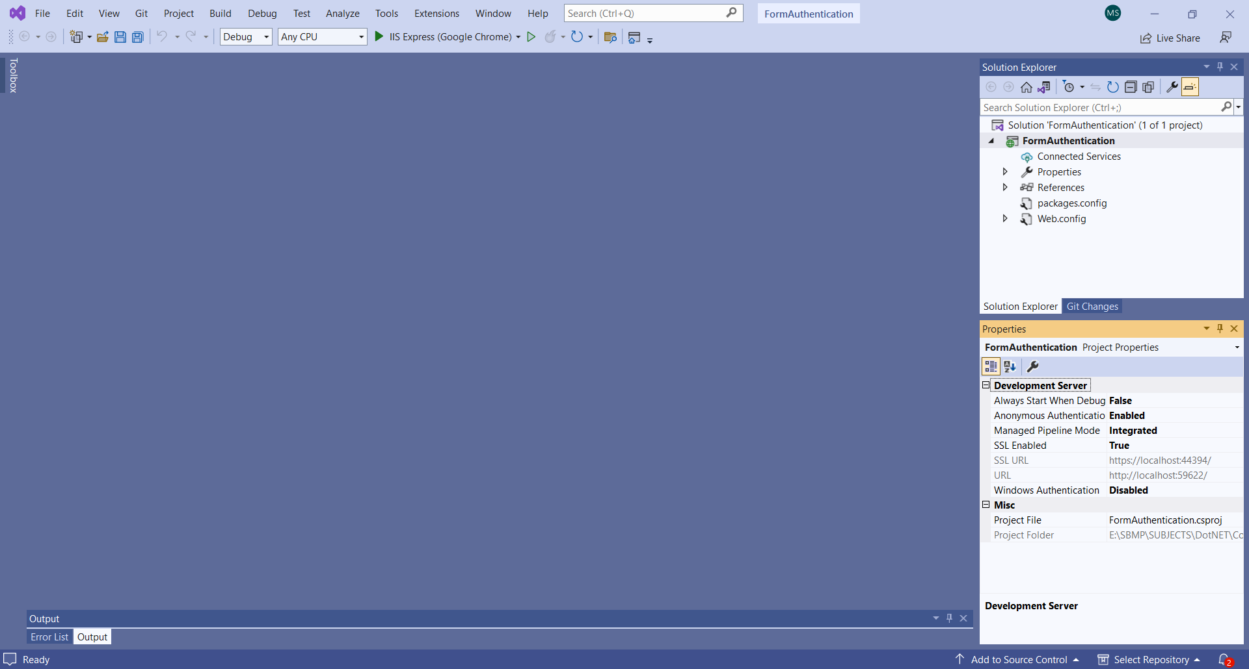

Slide 99
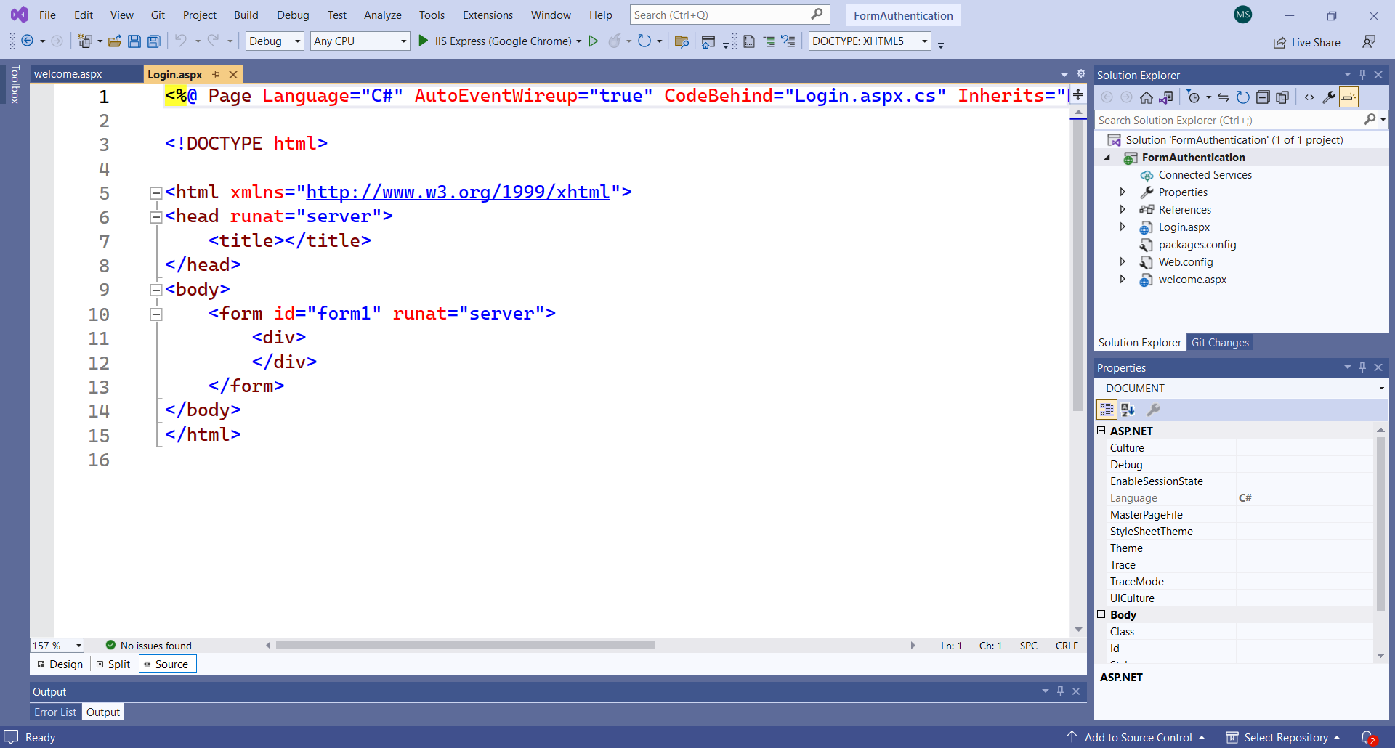
Add 2 web forms i.e. login.aspx and welcome.aspx

Slide 100
<!DOCTYPE html>
<html
xmlns="http://www.w3.org/1999/xhtml">
<head runat="server">
<title></title>
</head>
<body>
<form id="form1" runat="server">
<h3>
Login Page</h3>
<table>
<tr>
<td>
UserName:</td>
<td>
<asp:TextBox ID="UserName" runat="server" />
</td>
<td>
<asp:RequiredFieldValidator ID="RequiredFieldValidator1"
ControlToValidate="UserName"
Display="Dynamic"
ErrorMessage="Cannot be empty."
runat="server" />
</td>
</tr>

Slide 101
<tr>
<td>
Password:</td>
<td>
<asp:TextBox ID="UserPass" TextMode="Password"
runat="server" />
</td>
<td>
<asp:RequiredFieldValidator ID="RequiredFieldValidator2"
ControlToValidate="UserPass"
ErrorMessage="Cannot be empty."
runat="server" />
</td>
</tr>
<tr>
<td>
Remember me?</td>
<td>
<asp:CheckBox ID="chkboxPersist" runat="server" />
</td>
</tr>
</table>
<asp:Button ID="Submit1" OnClick="Login_Click" Text="Log In"
runat="server" />
<p>
<asp:Label ID="Msg" ForeColor="red" runat="server" />
</p>
</form>
</body>
</html>

Slide 102
protected Boolean Authenticate(String uname,String password)
{
if (uname.CompareTo("student")==0 && password.CompareTo("stu@123")==0)
return true;
return false;
}
protected void Login_Click(object sender, EventArgs e)
{
if (Authenticate(UserName.Text, UserPass.Text))
{
Response.Redirect("welcome.aspx");
Response.End();
}
else
{
Msg.Text = "Invalid User Name and/or Password";
}
}

Slide 103
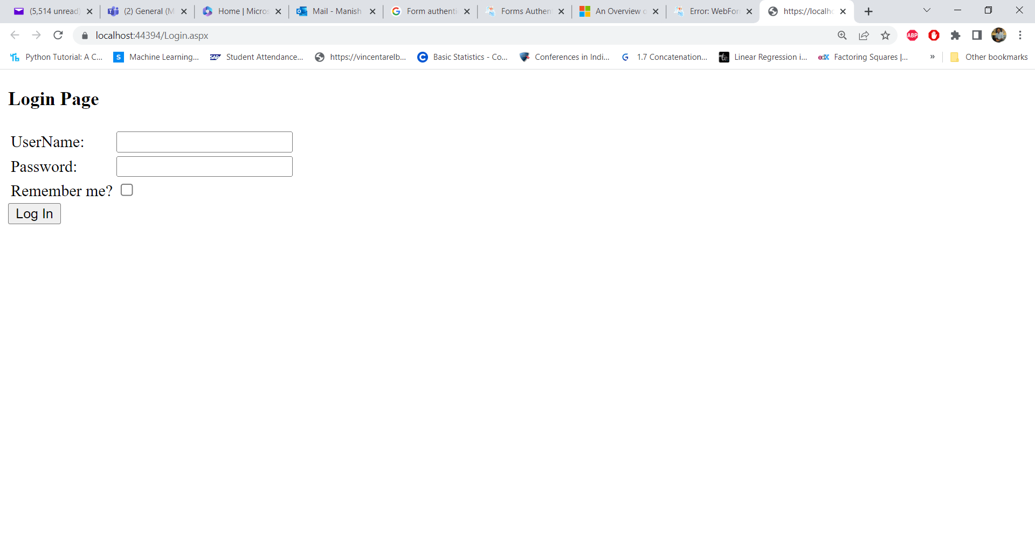

Slide 104
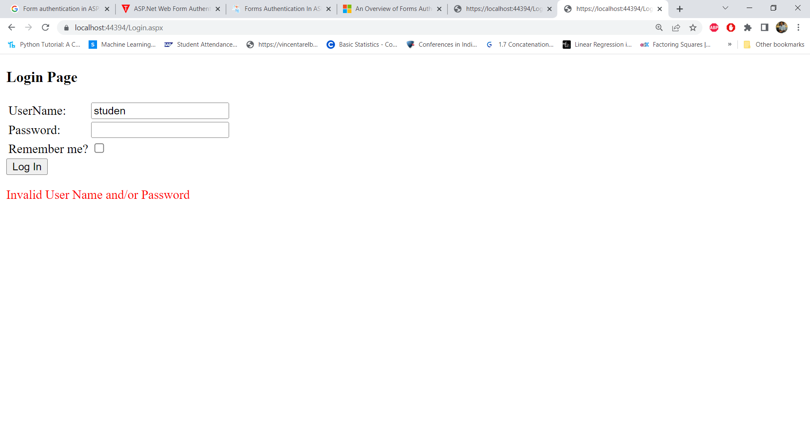
Invalid User

Slide 105
Another Code to authenticate user name & password
protected void LoginButton_Click(object sender, EventArgs e)
{ // Three valid username/password pairs: Scott/password, Jisun/password, and Sam/password.
string[] users = { "Scott", "Jisun", "Sam" };
string[] passwords = { "password", "password", "password" };
for (int i = 0; i < users.Length; i++)
{
bool validUsername = (string.Compare(UserName.Text, users[i], true) == 0);
bool validPassword = (string.Compare(Password.Text, passwords[i], false) == 0);
if (validUsername && validPassword) {
// TODO: Log in the user... // TODO: Redirect them to the appropriate page
} }
// If we reach here, the user's credentials were invalid
InvalidCredentialsMessage.Visible = true; }
https://learn.microsoft.com/en-us/aspnet/web-forms/overview/older-versions-security/introduction/an-overview-of-forms-authentication-cs

Slide 106
using System;
namespace CsharpString {
class Test {
public static void Main(string [] args) {
string str1 = "Programiz";
string str2 = "programiz";
int result;
// compares str1 and str2
result = String.Compare(str1, str2);
Console.WriteLine(result);
Console.ReadLine();
}
}
}

Slide 107
Using web.config

Slide 108
Now we set web.config file to implement the authentication of web application.
<system.web>
<compilation debug="true" targetFramework="4.7.2" />
<authentication mode="Forms">
<forms loginUrl="login.aspx" defaultUrl="welcome.aspx">
<credentials passwordFormat="Clear">
<user name="student" password="stu@123"/>
<user name="faculty" password="fac@123" />
</credentials>
</forms>
</authentication>
<authorization>
<deny users="?"/>
</authorization>
<httpRuntime targetFramework="4.7.2" />
</system.web>

Slide 109
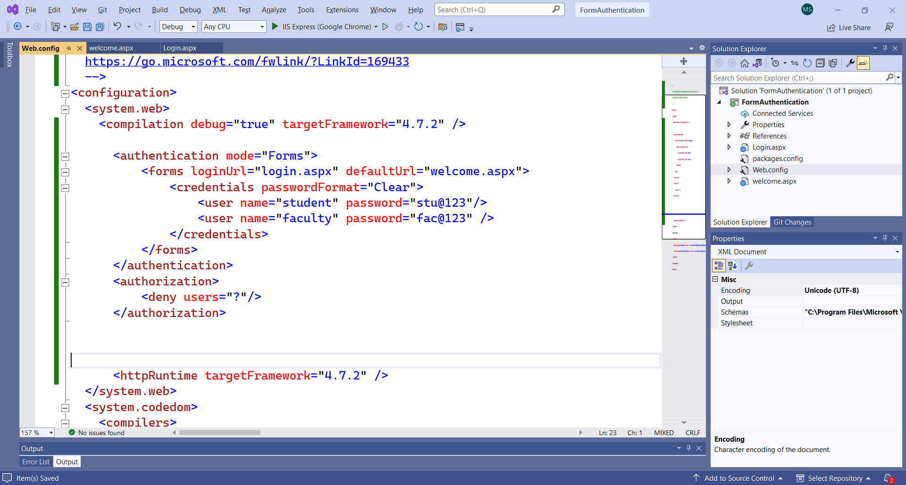

Slide 110
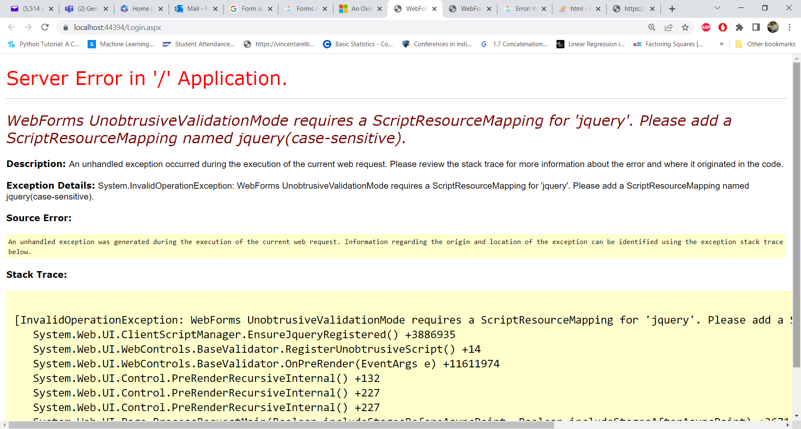
While running the login.aspx form, we will get an error of Event handling button and after providing that function we will get the following error

Slide 111
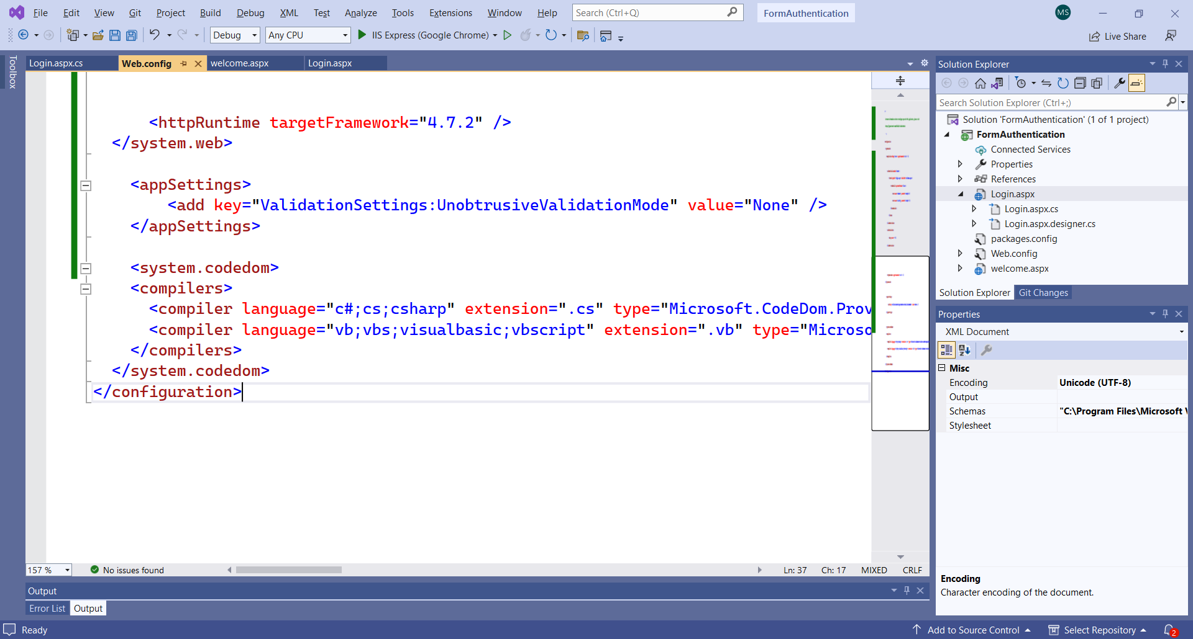
SOLUTION: Add the key in the web.config file
<appSettings>
<add key="ValidationSettings:UnobtrusiveValidationMode" value="None" />
</appSettings>
https://stackoverflow.com/questions/16660900/webforms-unobtrusivevalidationmode-requires-a-scriptresourcemapping-for-jquery

Slide 112
<system.web>
<compilation debug="true" targetFramework="4.7.2" />
<authentication mode="Forms">
<forms loginUrl="login.aspx" defaultUrl="welcome.aspx">
<credentials passwordFormat="Clear">
<user name="student" password="stu@123"/>
<user name="faculty" password="fac@123" />
</credentials>
</forms>
</authentication>
<authorization>
<deny users="?"/>
</authorization>
<httpRuntime targetFramework="4.7.2" />
</system.web>
<appSettings>
<add key="ValidationSettings:UnobtrusiveValidationMode" value="None" />
</appSettings>

Slide 113
if (FormsAuthentication.Authenticate(UserName.Text, UserPass.Text))
{
FormsAuthentication.RedirectFromLoginPage(UserName.Text, chkboxPersist.Checked);
}
else
{
Msg.Text = "Invalid User Name and/or Password";
}

Slide 114
https://www.c-sharpcorner.com/UploadFile/fa9d0d/forms-authentication-in-Asp-Net/
https://learn.microsoft.com/en-us/aspnet/web-forms/overview/older-versions-security/introduction/an-overview-of-forms-authentication-cs
https://www.c-sharpcorner.com/UploadFile/sourabh_mishra1/sending-an-e-mail-using-Asp-Net-with-C-Sharp/

Slide 115
Sending an Email

Slide 116
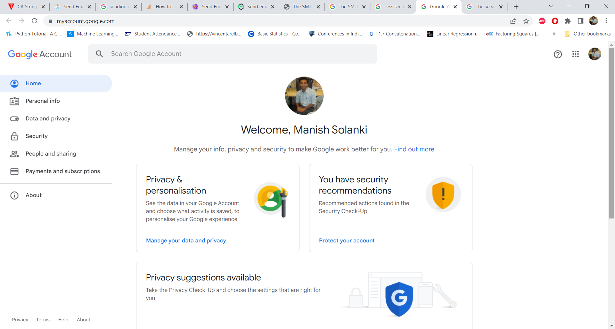

Slide 117
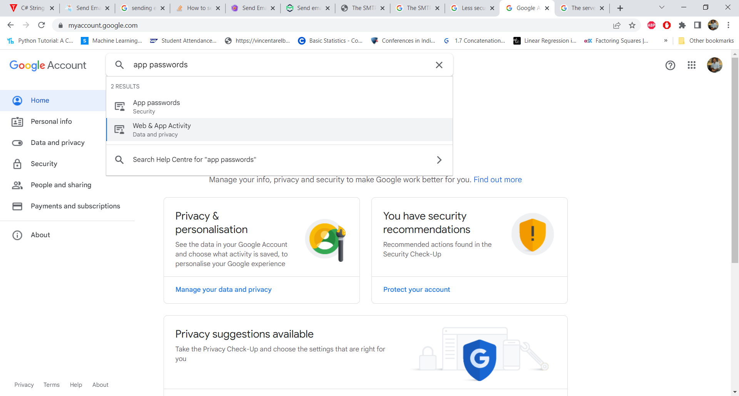

Slide 118
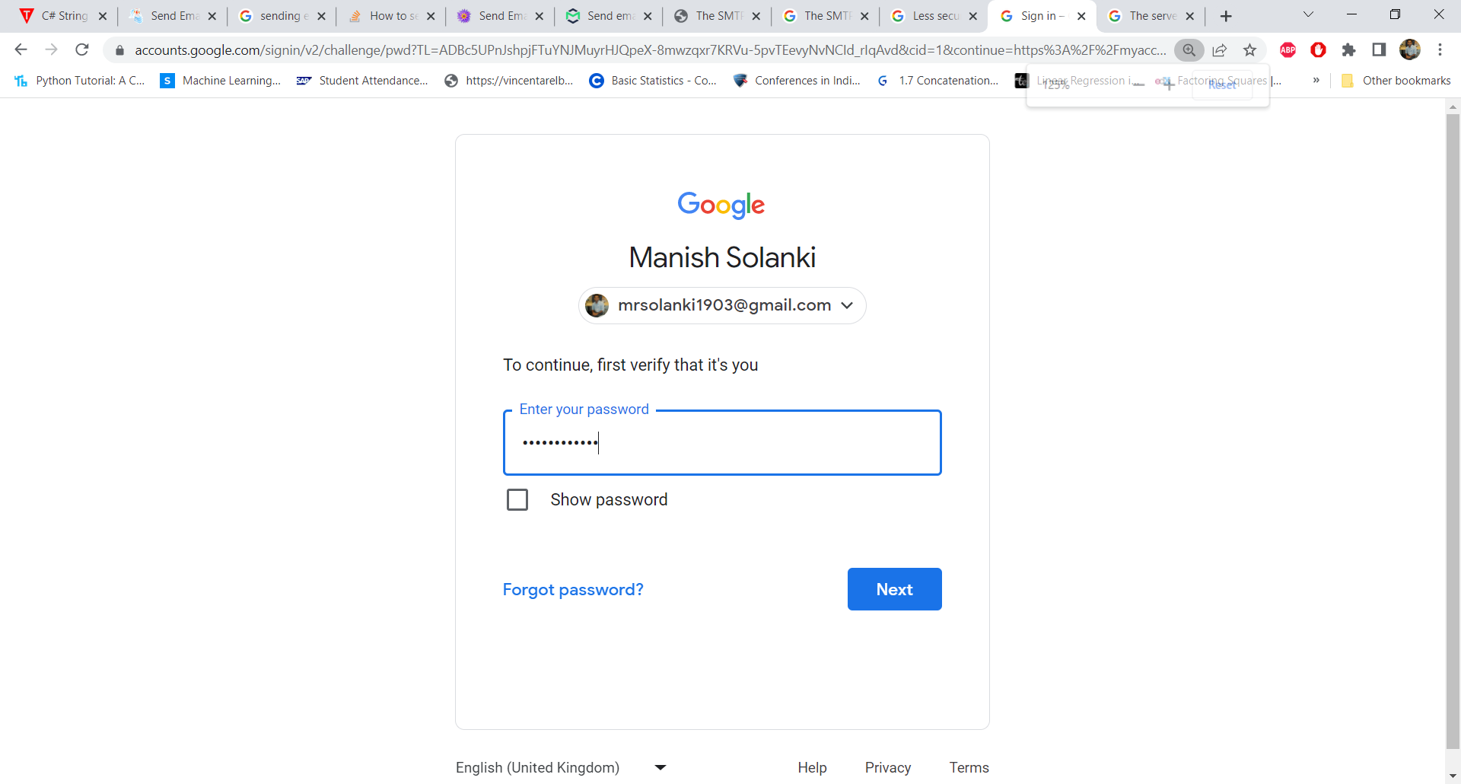

Slide 119
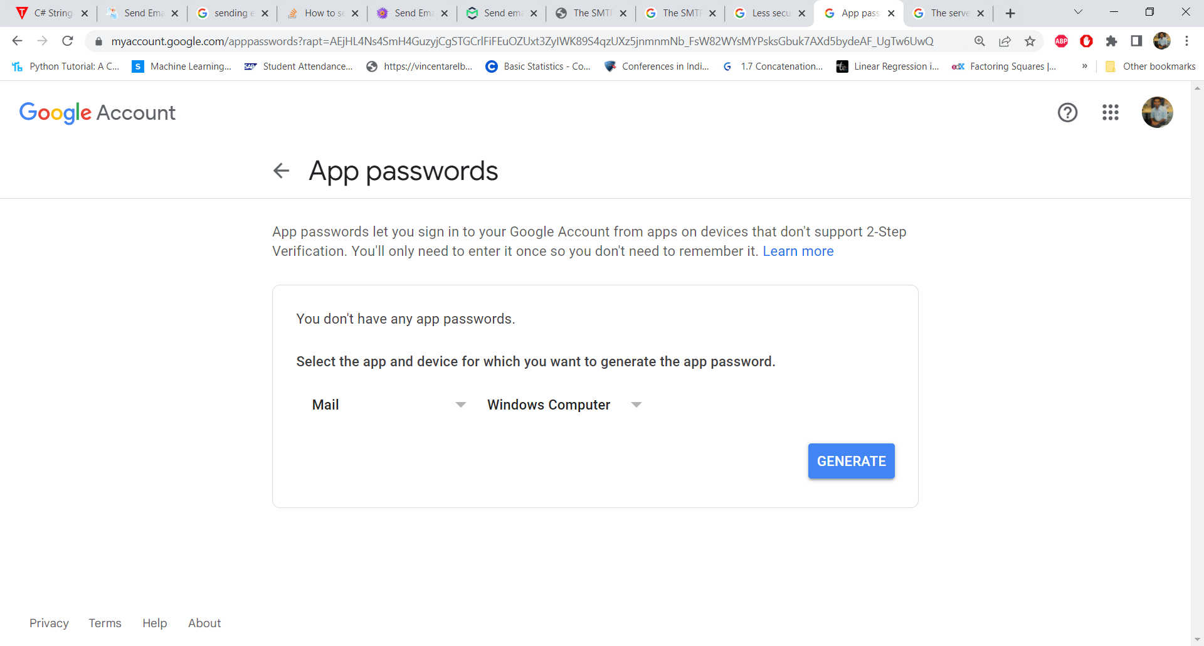

Slide 120
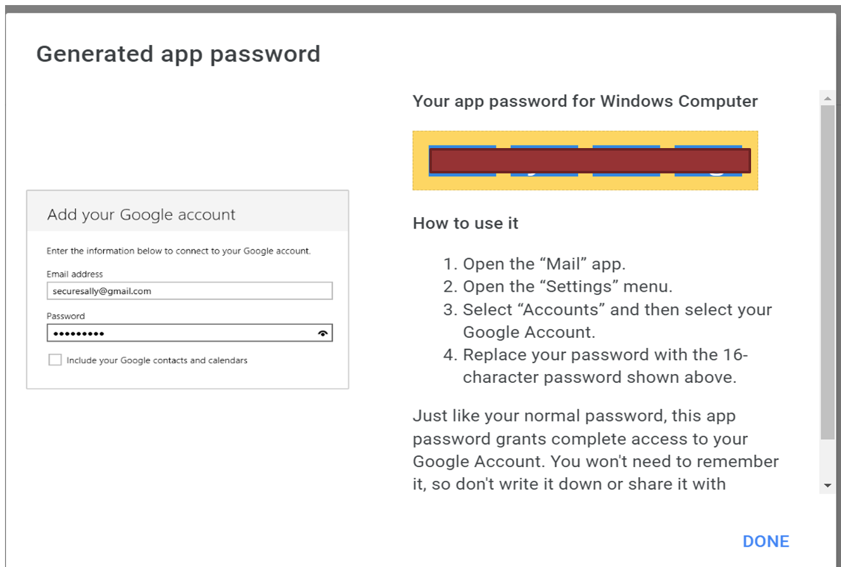

Slide 121
Web.conf
<system.net>
<mailSettings>
<smtp deliveryMethod="Network" from="mrsolanki1903@gmail.com">
<network
host="smtp.gmail.com"
port="587"
enableSsl="true"
userName="mrsolanki1903@gmail.com"
password= "16 character code"
defaultCredentials="true"/>
</smtp>
</mailSettings>
</system.net>
<appSettings>
<add key="ValidationSettings:UnobtrusiveValidationMode" value="None" />
</appSettings>
https://www.aspsnippets.com/Articles/Send-Email-with-example-in-ASPNet-using-C-and-VBNet.aspx

Slide 122
<!DOCTYPE html PUBLIC "-//W3C//DTD XHTML 1.0 Transitional//EN" "http://www.w3.org/TR/xhtml1/DTD/xhtml1-transitional.dtd">
<html xmlns="http://www.w3.org/1999/xhtml">
<head runat="server">
<title></title>
<style type="text/css">
body
{
font-family: Arial;
font-size: 10pt;
}
table
{
border: 1px solid #ccc;
border-collapse: collapse;
}
table th, table td
{
padding: 5px;
}
table, table table td
{
border: 0px solid #ccc;
}
</style>
</head>

Slide 123
<body>
<form id="form1" runat="server">
<table border="0" cellpadding="0" cellspacing="0">
<tr>
<td>To:</td>
<td><asp:TextBox ID="txtTo" runat="server" /></td>
</tr>
<tr>
<td>Subject:</td>
<td><asp:TextBox ID="txtSubject" runat="server" /></td>
</tr>
<tr>
<td valign = "top">Body:</td>
<td><asp:TextBox ID="txtBody" runat="server" TextMode="MultiLine" Height="150" Width="200" /></td>
</tr>
<tr>
<td></td>
<td><asp:Button ID="btnSend" Text="Send" runat="server" OnClick = "SendEmail" /></td>
</tr>
</table>
</form>
</body>
</html>

Slide 124
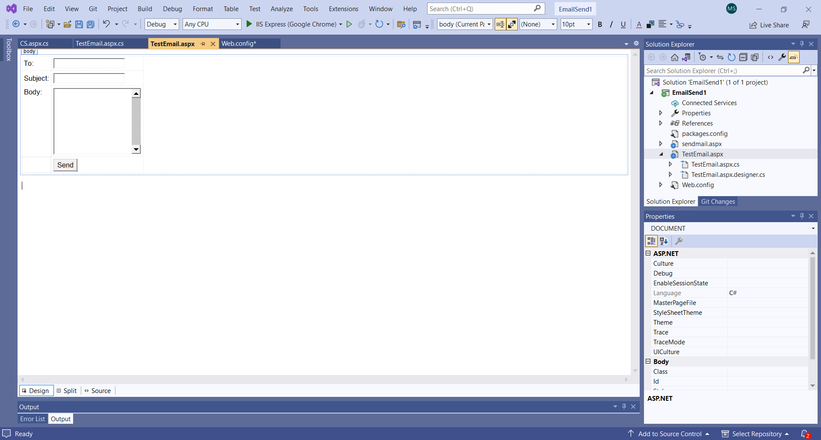
https://www.aspsnippets.com/Articles/Send-Email-with-example-in-ASPNet-using-C-and-VBNet.aspx

Slide 125
using System;
using System.Collections.Generic;
using System.Linq;
using System.Web;
using System.Web.UI;
using System.Web.UI.WebControls;
using System.Net;
using System.Net.Mail;
using System.Web.Services;
using System.Configuration;
using System.Net.Configuration;
namespace EmailSend1
{
public partial class TestEmail : System.Web.UI.Page
{
protected void Page_Load(object sender, EventArgs e)
{
}

Slide 126
protected void SendEmail(object sender, EventArgs e)
{
SmtpSection smtpSection = (SmtpSection)ConfigurationManager.GetSection("system.net/mailSettings/smtp");
using (MailMessage mm = new MailMessage(smtpSection.From, txtTo.Text.Trim()))
{
mm.Subject = txtSubject.Text.Trim();
mm.Body = txtBody.Text.Trim();
mm.IsBodyHtml = false;
SmtpClient smtp = new SmtpClient();
smtp.Host = smtpSection.Network.Host;
smtp.EnableSsl = smtpSection.Network.EnableSsl;
NetworkCredential networkCred = new NetworkCredential(smtpSection.Network.UserName, smtpSection.Network.Password);
smtp.UseDefaultCredentials = smtpSection.Network.DefaultCredentials;
smtp.Credentials = networkCred;
smtp.Port = smtpSection.Network.Port;
smtp.Send(mm);
ClientScript.RegisterStartupScript(this.GetType(), "alert", "alert('Email sent.');", true);
}
}
}
}

Slide 127
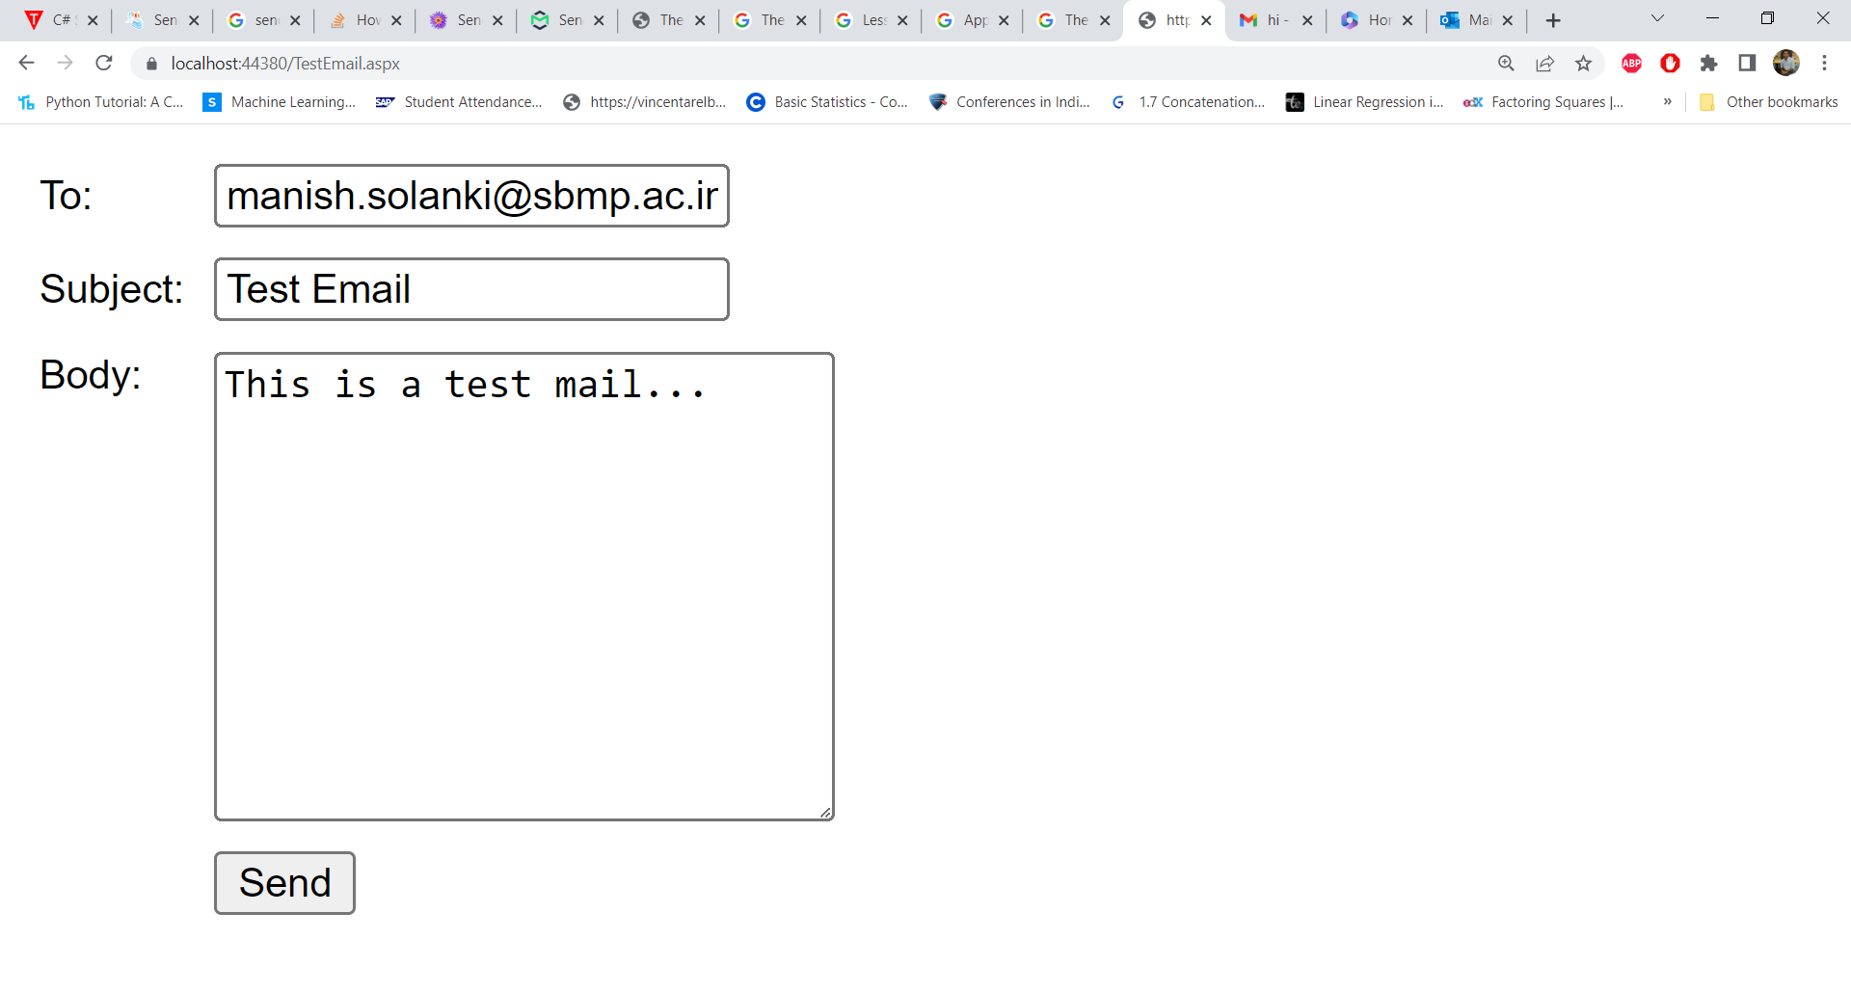

Slide 128


Slide 129


Slide 130
SENDING EMAIL TRHOUGH C# PROGRAM with Attachment

Slide 131
<!DOCTYPE html>
<html
xmlns="http://www.w3.org/1999/xhtml">
<head runat="server">
<title></title>
</head>
<body>
<form id="form1" runat="server">
<table align="center" width="60%">
<tr>
<td>to</td>
<td>
<asp:TextBox ID="to" runat="server" Width="99%">
</asp:TextBox>
<asp:RequiredFieldValidator ID="RequiredFieldValidatorTo" runat="server" ErrorMessage="Field is Required" ForeColor="Red" ControlToValidate="to">
</asp:RequiredFieldValidator>
<asp:RegularExpressionValidator ID="ExpValidatorTo" runat="server" ErrorMessage="Email is invalid"
ValidationExpression="\w+([-+.']\w+)*@\w+([-.]\w+)*\.\w+([-.]\w+)*" ControlToValidate="to">
</asp:RegularExpressionValidator>
</td>
</tr>
<tr>

Slide 132
<td>from</td>
<td>
<asp:TextBox ID="from" runat="server" Width="99%">
</asp:TextBox>
<asp:RequiredFieldValidator ID="RequiredFieldValidatorFrom" runat="server"
ErrorMessage="Field is Required" ForeColor="Red" ControlToValidate="from">
</asp:RequiredFieldValidator>
<asp:RegularExpressionValidator ID="ExpValidatorFrom" runat="server"
ErrorMessage="Email is invalid"
ValidationExpression="\w+([-+.']\w+)*@\w+([-.]\w+)*\.\w+([-.]\w+)*" ControlToValidate="from">
</asp:RegularExpressionValidator>
</td>
</tr>
<tr>
<td>subject</td>
<td>
<asp:TextBox ID="subject" runat="server" Width="99%">
</asp:TextBox>
<asp:RequiredFieldValidator ID="RequiredFieldValidatorsubject" runat="server"
ErrorMessage="Field is Required" ForeColor="Red" ControlToValidate="subject">
</asp:RequiredFieldValidator>
</td>
</tr>

Slide 133
<tr>
<td>body</td>
<td>
<asp:TextBox ID="body" runat="server" Width="99%" Height="150px" TextMode="MultiLine">
</asp:TextBox>
<asp:RequiredFieldValidator ID="RequiredFieldValidatorbody" runat="server"
ErrorMessage="Field is Required" ForeColor="Red" ControlToValidate="body">
</asp:RequiredFieldValidator>
</td>
</tr>
<tr>
<td>file upload</td>
<td>
<asp:FileUpload runat="server" AllowMultiple="true" ID="upload">
</asp:FileUpload>
</td>
</tr>
<tr>
<td></td>
<td>
<asp:Button ID="send" OnClick="send_click" runat="server" Text="send"/>
</td>
</tr>
<tr>
<td></td>
<td>
<asp:Label ID="status" runat="server">
</asp:Label>
</td>
</tr>
</table>
</form>
</body>
</html>

Slide 134
using System;
using System.Collections.Generic;
using System.Linq;
using System.Net.Mail;
using System.Web;
using System.Web.UI;
using System.Web.UI.WebControls;
namespace EmailSend1
{
public partial class sendmail : System.Web.UI.Page
{
protected void Page_Load(object sender, EventArgs e)
{
}

Slide 135
protected void send_click(object sender, EventArgs e)
{
try
{
MailMessage message = new MailMessage(from.Text,to.Text);
message.Subject = subject.Text.Trim();
message.Body = body.Text.Trim();
if (upload.HasFile)
{
HttpFileCollection fc = Request.Files;
for (int i = 0; i <= fc.Count - 1; i++)
{
HttpPostedFile pf = fc[i];
Attachment attach = new Attachment(pf.InputStream, pf.FileName);
message.Attachments.Add(attach);
}
}
SmtpClient client = new SmtpClient("smtp.gmail.com", 587);
client.EnableSsl = true;
client.DeliveryMethod = SmtpDeliveryMethod.Network;
client.UseDefaultCredentials = false;
client.Credentials = new System.Net.NetworkCredential("mrsolanki1903@gmail.com", “16 CHAR CODE");
client.Send(message);
status.Text = "message was sent successfully";
}
catch (Exception ex)
{
status.Text = ex.StackTrace;
}
}
}
}

Slide 136
https://www.c-sharpcorner.com/UploadFile/sourabh_mishra1/sending-an-e-mail-using-Asp-Net-with-C-Sharp/

Slide 137


Slide 138


Slide 139


Slide 140


Slide 141


Slide 142
Sessions
Session is a state management technique that is used to manage the state of a page or control throughout the application. Using the session we can store the value and access it in another page or throughout the application.

Slide 143
WHY Sessions?
HTTP is a stateless protocol, it means every request is an independent request.
Browser does not know about previous request and data. So, every previous request data lost and you cannot retrieve previous data.
Using the session, we store the data in session and access it anywhere as per requirement. It provides application level state management.

Slide 144


Slide 145


Slide 146
Create a WebForm1 i.e. ogin.aspx
<!DOCTYPE html PUBLIC "-//W3C//DTD XHTML 1.0 Transitional//EN" "http://www.w3.org/TR/xhtml1/DTD/xhtml1-transitional.dtd">
<html xmlns="http://www.w3.org/1999/xhtml">
<head id="Head1" runat="server">
<title></title>
</head>
<body>
<form id="form1" runat="server">
<div>
User Name:-<asp:TextBox ID="tbUserName" runat="server"></asp:TextBox>
<br />
<br />
Password:-<asp:TextBox ID="tbpwd" runat="server"></asp:TextBox>
<br />
<asp:Button ID="Button1" runat="server" OnClick="Button1_Click" Text="Submit" />
</div>
</form>
</body>
</html>

Slide 147
Create a WebForm2 i.e. Greeting.aspx
<!DOCTYPE html PUBLIC "-//W3C//DTD XHTML 1.0 Transitional//EN" "http://www.w3.org/TR/xhtml1/DTD/xhtml1-transitional.dtd">
<html xmlns="http://www.w3.org/1999/xhtml">
<head id="Head1" runat="server">
<title></title>
</head>
<body>
<form id="form1" runat="server">
<div>
User Name:-<asp:TextBox ID="tbUserName" runat="server"></asp:TextBox>
<br />
<br />
Password:-<asp:TextBox ID="tbpwd" runat="server"></asp:TextBox>
<br />
</div>
</form>
</body>
</html>

Slide 148
Create Session in Login.aspx.cs file’s Butoon1_Click() event and redirect to “Greeting.aspx “
protected void Button1_Click(object sender, EventArgs e)
{
//textbox value is stored in Session
Session["UserName"] = tbUserName.Text;
Session["Pwd"] = tbpwd.Text;
Response.Redirect("Greeting.aspx");
}

Slide 149
Retrieve session data in Load_Page() of Greeting.aspx.cs file
protected void Page_Load(object sender, EventArgs e)
{
//Session value is assign on the text box
if (Session["UserName"] != null)
{
tbUserName.Text = Session["UserName"].ToString();
}
if (Session["Pwd"] != null)
{
tbpwd.Text = Session["Pwd"].ToString();
}
}

Slide 150


Slide 151


Slide 153

Home.aspx

Slide 154

Home.aspx.cs

Slide 155

login.aspx

Slide 156

login.aspx.cs

Slide 157
Web.config
<system.web>
<sessionState timeout="1"> </sessionState>
</system.web>

Slide 160

Home.aspx is requested

Slide 161

Redirected to login form

Slide 162

User Login

Slide 163

Login successful

Slide 164

After 1 minute or pressing “logout” button, the page is redirected to login form due to session expiration

Slide 165

Invalid user, you display error page

Slide 166
Sessions
https://www.c-sharpcorner.com/UploadFile/225740/introduction-of-session-in-Asp-Net/

Slide 167
Thanks!
Any questions?
You can find me at:
manish_ratilal2002@yahoo.com

Slide 168
Credits
https://learn.microsoft.com/en-us/aspnet/web-forms/overview/getting-started/creating-a-basic-web-forms-page
https://www.tutorialride.com/asp-net/asp-net-controls.htm
https://www.youtube.com/watch?v=exut2zG5GEo&ab_channel=CoderBaba
https://learn.microsoft.com/en-us/troubleshoot/developer/webapps/aspnet/development/server-controls
Web API https://www.youtube.com/watch?v=1fmRiELQAfU&ab_channel=Simplilearn
https://www.aspsnippets.com/Articles/Simple-User-Registration-Form-Example-in-ASPNet.aspx
Database Connectivity
https://www.dotnettutorial.co.in/2019/03/registration-form-in-aspnet-with-store-procedure.html

Slide 169
Credits
Client & Server Side Validation code
https://www.c-sharpcorner.com/article/textbox-validation-client-side-and-server-side-in-asp-net-webform/
Validation Controls & Custom Validators
https://www.c-sharpcorner.com/UploadFile/puranindia/validation-controls-in-Asp-Net/

